Slide 1
Taverna Workbench – Case studies
Helen Hulme

Slide 2
Do you really need to use workflows?
Bioinformaticians are programmers
Can use shell scripts
Are used to converting data between different formats
So do we really need to use middleware?
Notes:
Bioinformaticians work at every interface, from the tech-face to Biology facing. But all are going to be skilled at: scripting, programming, pipelining data using e.g. shell scripts – do you need a workflow system to help you to do something you can already do?......

Slide 3
Well…
Scripts work – “works on my machine”….
Programming is essential – addition of middleware provides a framework / organization
E.g. NGS data – where is the bottleneck?

Slide 4
What does a workflow system add?
Conceptualize
Visualize
Re-runnable / repeatable
Sharing
Scheduling
Pushing the methods out from developers to the users
Notes:
Organising into a workflow is part of a design process, can make the concepts more transparent – the workflow is both a practical engine for actually carrying out the analysis - at the same time it is a theoretical description of the analysis.
Visualise: Humans are visual creatures – Biologists especially so – biological concepts are best described with diagrams. Methods are well described by workflows.

Slide 5

Wellcome Trust Host Pathogen project
Liverpool – Manchester – ILRI (Kenya) – Roslin (Edinburgh) project looking at T. Congolense in
Cattle breeds (Ndama / Boran)
Mouse model (strains AJ, BalbC, C57Bl6)
Workflows: Paul Fisher

Slide 6
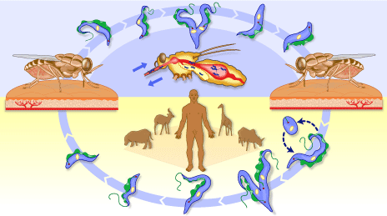
Case study 1: African sleeping sickness
Disease caused by Trypanasoma Congolense
Image: W.H.O.

Slide 7
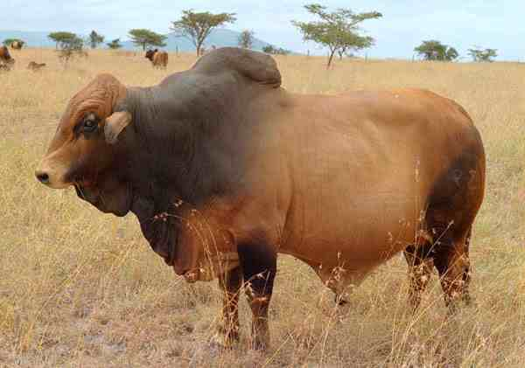
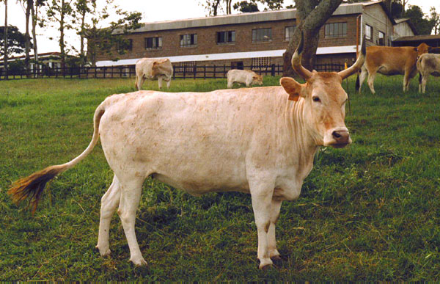
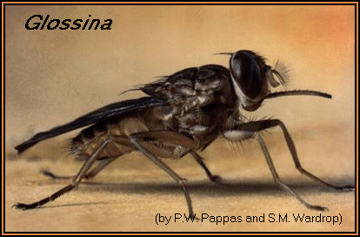
Origins of N’Dama and Boran cattle
Boran
N’Dama

Slide 8
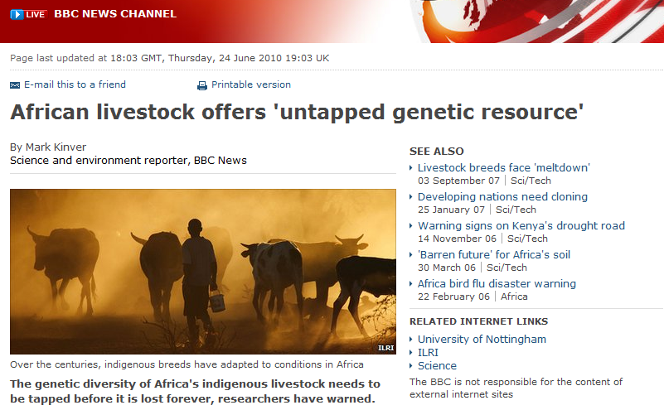
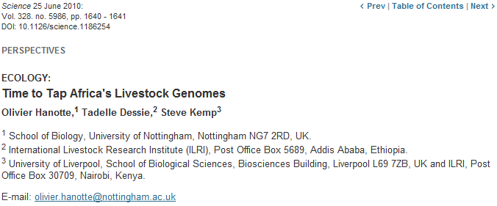
African Cattle
Different breeds of African Cattle
10,000 years separation
African Livestock adaptations:
More productive
Increases disease resistance
Selection of traits
Potential outcomes:
Food security
Understanding resistance
Understanding environmental
Understanding diversity
http://www.bbc.co.uk/news/10403254

Slide 9
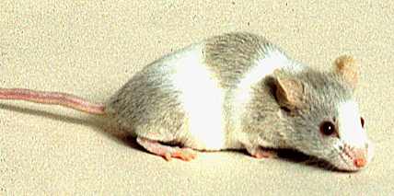
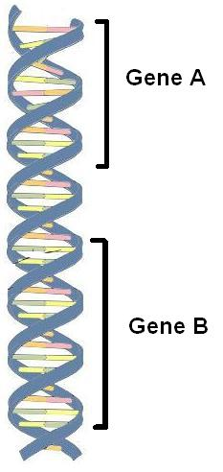
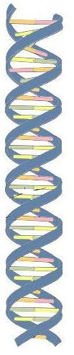
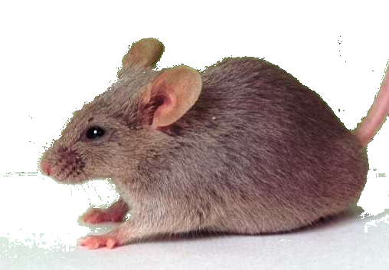
Linking Genotype to Phenotype
vs.
Genes
DNA
Mutations
ACTGCACTGACTGTACGTATATCT
ACTGCACTGTGTGTACGTATATCT
Notes:
Genotype definition
Genotype – the genes or genetic identity of an individual, which most importantly does not show any outward characteristics
Examples include DNA sequence, genes encoded in the DNA, and even mutations in those genes

Slide 10
Data analysis
Identify pathways that have responding genes
Identify pathways from Quantitative Trait genes (QTg)
Track genes through pathways that are suspected of being relevant
Identify clusters of responding genes that have common transcription factor binding sites.

Slide 11
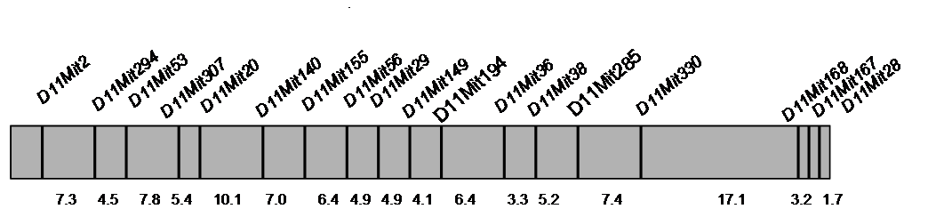
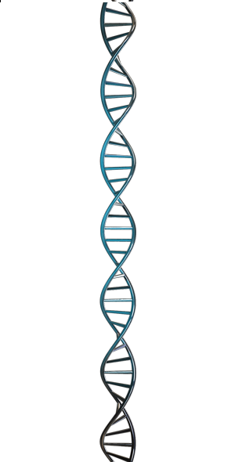
Quantitative Trait Loci (QTL)
Classical genetics / markers
F2 populations
LOD scores
QTLs can span
small regions containing few genes
encompass almost entire chromosomes containing 100’s of genes
QTL

Slide 12
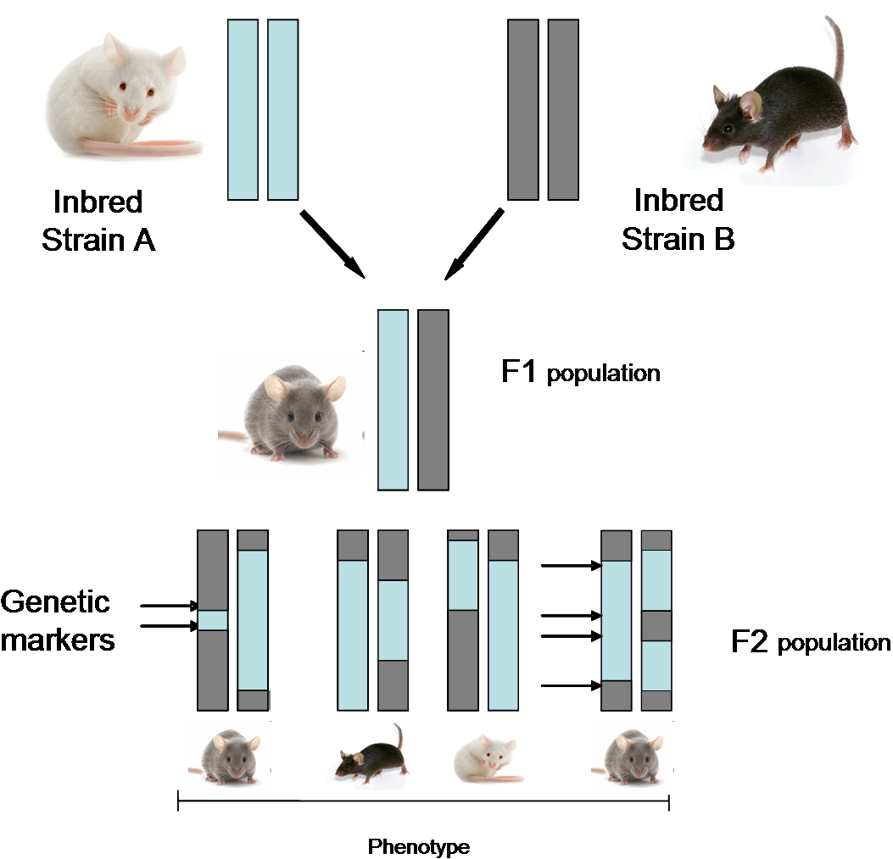
Quantitative Trait Loci - QTL

Slide 13
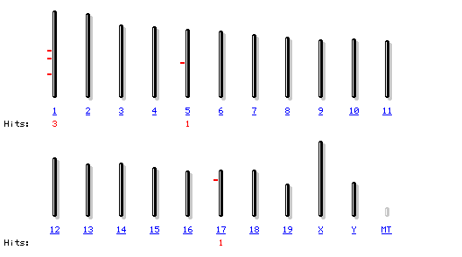
Trypanosoma infection response (Tir) QTL
C57/BL6 x AJ and C57/BL6 x BALB/C
Iraqi et al Mammalian Genome 2000 11:645-648
Kemp et al. Nature Genetics 1997 16:194-196

Slide 14
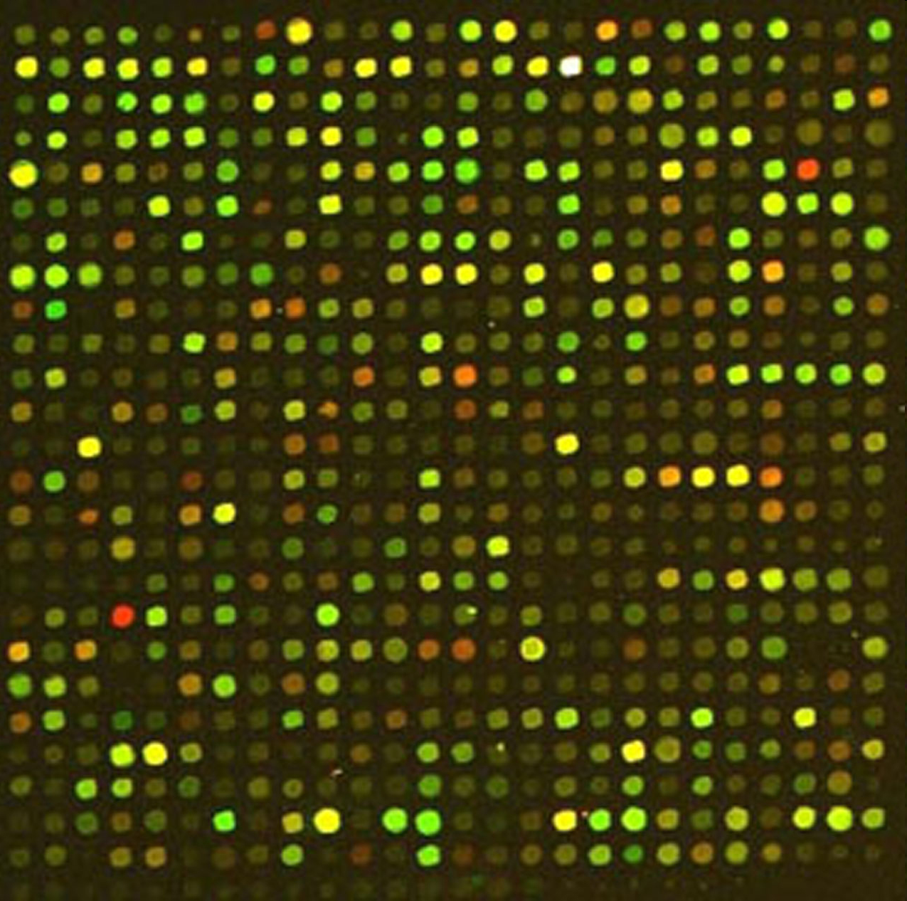
Gene Expression
Microarrays are glass slides that have spots of genetic code printed on them
Each spot represents a probe
A probe is a short sequence of RNA (20-25 bases long)
There are numerous probes per gene, called probesets
A probeset shows the expression of a gene in a condition
This can be used to find genes that are up or down regulated
These genes would be candidate genes for drug targeting / gene therapy..etc

Slide 15

The experiment
A total of 225 microarrays
Liver
AJ
Spleen
Balb/c
Kidney
C57
Tryp challenge
0
3
7
9
17

Slide 16
QTL + Microarrays
This will be the focus of my talk.
Notes:
QTL for linage studies and identifying genes for complex traits
Microarrays for looking at gene expression studies
Finding out what genes are expressed during a phenotypes expression
Good for finding the functional significance of a phenotypes expression, pathway level studies
This is what I will be focussing on

Slide 17
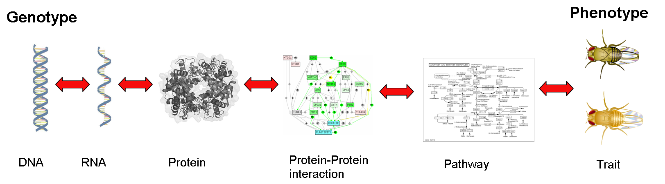
The Central Dogma
Notes:
Background
Here we have some basic definitions of what a genotype and phenotype are:
Genotype – the genes or genetic identity of an individual, which most importantly does not show any outward characteristics
Phenotype – the expression of genes which do show observable characteristics or traits
It has long been established that genes and DNA are the programs controlling life.
The central dogma of biology is that:
a DNA sequence is transcribed into an RNA sequence.
RNA is then translated into a protein or peptide sequence
The protein sequence folds to create a protein
The protein interacts with many other proteins forming interaction networks
These interaction networks interact to form biological pathways
Which in turn influence the expression of a phenotype

Slide 18
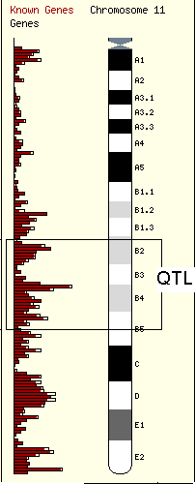
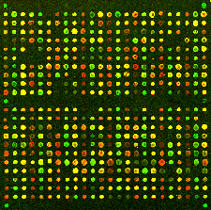
Huge amounts of data
QTL region on chromosome
Microarray
200+ Genes
1000+ Genes
How do I look at ALL the genes systematically?
Notes:
Vast amounts of data
We now have technologies to help with identification of candidate genes
But, there is still a problem with the amount of data generated by these high-throughput methods
QTL based investigation can easily produce over 200 genes per chromosome region, if there are 5 regions then there are a lot of genes to look at
Microarray gene expression studies map entire genomes to the chip (mouse 23,000 genes)
Those genes that show a change in their expression under the studied state are chosen
These can be in the 1000’s
Numbers of genes quickly overwhelms researchers
How do researches look at these candidate genes then?

Slide 19
Hypothesis-Driven Analyses
200 QTL genes
Pick the genes involved in immunological process
Case: African Sleeping sickness
- parasitic infection
- Known immune response
40 QTL genes
Pick the genes that I am most familiar with
2 QTL genes
Result: African Sleeping sickness
Immune response
Cholesterol control
Cell death
Biased view
Notes:
Hypothesis based approach
Researches follow a hypothesis based approach
This typically involves filtering or triaging the genes based on a predefined hypothesis
We found that they tended to filter the gene lists because they were focussed on their “favourite” genes
Immunologists picked the immunology genes
In fact this triaging can lead to expert-driven hypothesis generation
Some of the crucial data can be missed as it is not known that other processes other than those hypothesises are involved in a major way
Use case Tryps (going to discuss later) researchers assumed it had to do with immune response
Know known that other processes are involved that would not have been picked up using this method, including a cholesterol response

Slide 20
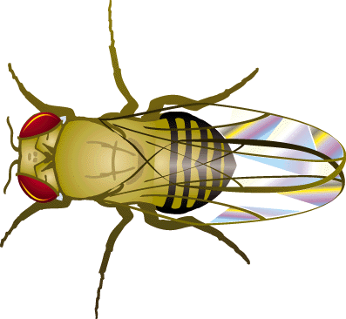
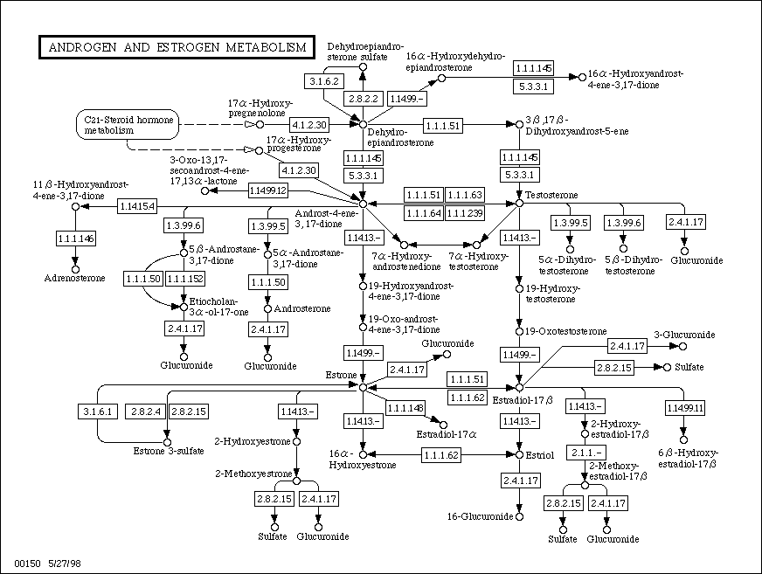
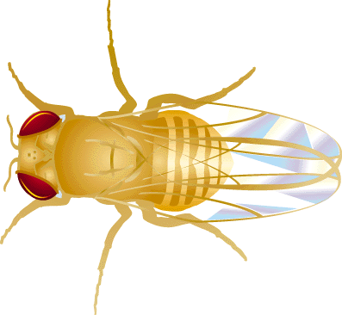
Genotype
Current Methods
Phenotype
200
?
What processes to investigate?
Notes:
Current approaches
This slide shows the current approaches to investigating genotype-phenotype correlations
The common approach in molecular biology is to investigate from the phenotype back to the underlying genes
However, looking from a phenotypic aspect, how do we know what processes to look at ?
Even for an obvious phenotype there may be many underlying biological processes or biological pathways interacting with one another
If we find these pathways, we may have several hundred genes interacting with one another each of which needs to be investigated further to determine its precise role in the phenotype
This leads to a bog or maze of information which process to be difficult to disseminate
The now widely adopted view in bioinformatics is to investigate at the level of genes – what genes are involved
If we look from a genotype aspect, what genes influence the phenotype ?
We can use Quantitative Trait Loci to map a phenotype to a region of chromosome
QTLs are determined by genetic mapping experiments which I’m not going to cover here, and are basically chromosomal regions, containing many genes, that have been proven to be involved to some degree in the expression of the phenotype
This makes them ideal for investigating relationships at the level of genes
The vast majority of QTLs encompass several hundred genes which makes it a problem for further analysis
There are also issues where many QTLs can interact to produce one overall phenotype as in one of our cases studies
And so this also leads us back to the same problem where we are also stuck in the middle with a mass of information, such as the many pathways the genes are involved in
One possible solution to begin our investigations is to start where the information is most rich, in the middle
To do this we can use microarray gene expression data

Slide 21
Genotype
Phenotype
200
?
Metabolic pathways
Phenotypic response investigated using microarray in form of expressed genes or evidence provided through QTL mapping
Genes captured in microarray experiment and present in QTL (Quantitative Trait Loci ) region
Microarray + QTL
Notes:
The middle-out approach
Utilising microarray data as a middle ground to investigating genotype-phenotype correlations enables us to begin our investigations from an information rich perspective
From the previous slide we showed that the expression of genes form proteins, and the interaction of proteins into pathways influence the overall phenotype.
From this we therefore find an ideal place in which to narrow down our search for possible correlations between genotype and phenotype
Pathways tell us what proteins, and therefore genes are involved in a particular biological process
If we know what pathways are involved in the phenotype we can find out what genes are involved
Using pathways in this manner is basically a noise and dimensionality reduction procedure
By determining which genes, and subsequently their pathways, are over or under expressed in our microarray study allows us to see what processes may be influencing our phenotype
However some of these may be due to noise in the data
We can then begin to look at the pathways from the genes in the QTL region
Cross correlating these two pathway lists shows us which genes in the QTL region and which pathways are directly influencing the phenotype

Slide 22
Hypothesis
Utilising the capabilities of workflows and the pathway-driven approach, we are able to provide a more:
- systematic
- efficient
- scalable
- un-biased
- unambiguous
the benefit will be that new biology results will be derived, increasing community knowledge of genotype and phenotype interactions.
Notes:
Hypothesis
So based on this information we have proposed a hypothesis that
The pathway-driven approach will enable us to investigate from an information rich perspective
Implementing the pathway-driven through workflows, we can investigate genotype-phenotype correlations systematically
Using workflows we can find where and why mistakes occur , e.g. biased introduced from field experts
Workflows can handle a far greater volume of data, and process it in a much quicker time, only limited by computational speed
Most importantly they should be capable of finding new biological results based on their systematic nature

Slide 23
QTL mapping study
Microarray gene expression study
Identify genes in QTL regions
Identify differentially expressed genes
Statistical analysis
Genomic Resource
Annotate genes with biological pathways
Annotate genes with biological pathways
Pathway Resource
Select common biological pathways
Workflow
Manual
Literature
Wet Lab
Hypothesis generation and verification
SNP
Notes:
Workflow approach
In order to implement this centralised pathway approach we developed 2 prototype workflows to gather pathways from both QTL and microarray data separately
The workflows obtained genes from a database, and annotated the genes with other identifiers
This enabled us to find the biological pathways for each gene
We then took the pathways that we knew contained genes from our microarray study (that were actually known to be doing something with the phenotype) and those genes that were mapped to the regions of chromosome
By comparing these two sets of pathways we could identify which genes and pathways were specifically involved in the phenotype
Each pathway was then looked up in the published literature (done by hand) to see if they any further information could be found related to our phenotype
The hypothesis generation is then an ongoing task to find in the literature any evidence of involvement of the pathways and test those hypotheses in the lab

Slide 24
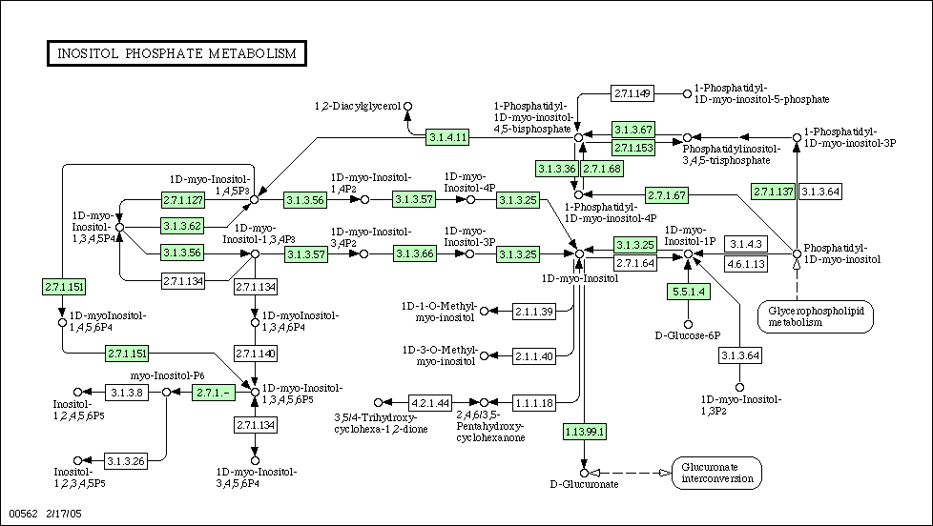
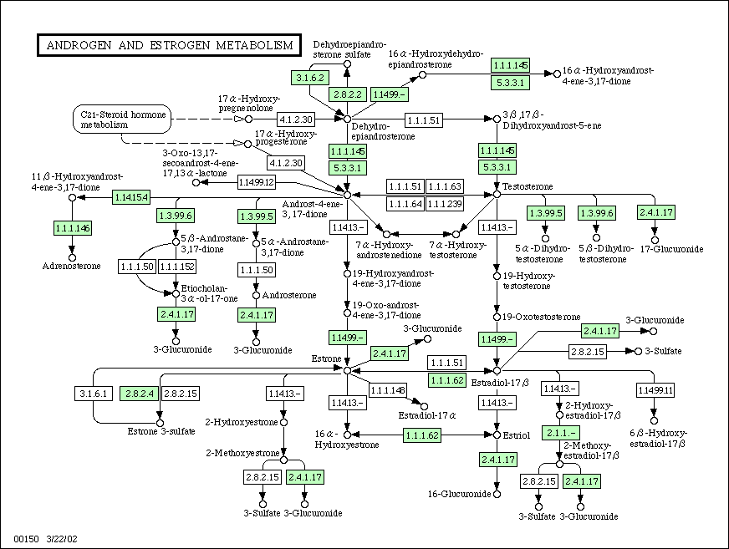
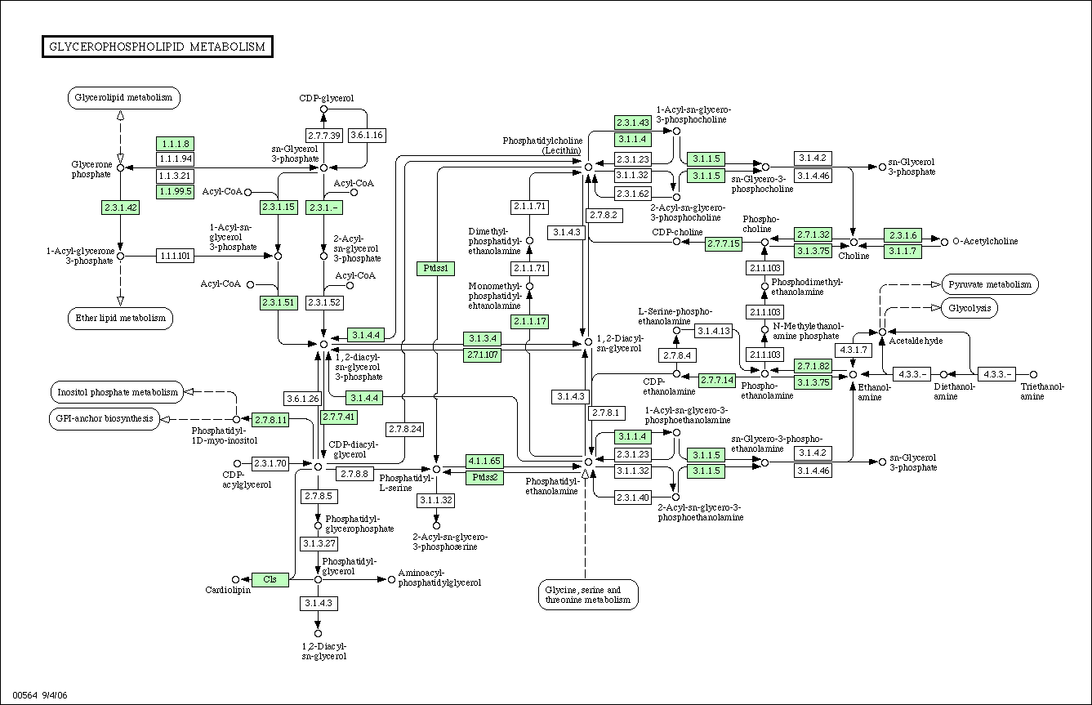
Expressed Pathways
Phenotype
CHR
Pathway A
SNP and literature
Pathway linked to phenotype and has SNP– high priority
QTL
Gene A
Gene B
Pathway B
SNP and literature
Pathway linked to phenotype with no SNP – medium priority
Gene C
Pathway C
SNP and literature
Genotype
Pathway not linked to QTL no SNP – low priority
Notes:
Pathway driven approach
Slide shows the prioritisation of phenotype candidates
All pathways are differentially expressed in the microarray data
Pathways which contain genes from the QTL region are assigned a high priority (pathways A and B)
Those with no link to the QTL region (pathway C) are given a low priority
Higher priority pathways are then ranked according to their involvement in the phenotypes expression, based on literature evidence

Slide 25
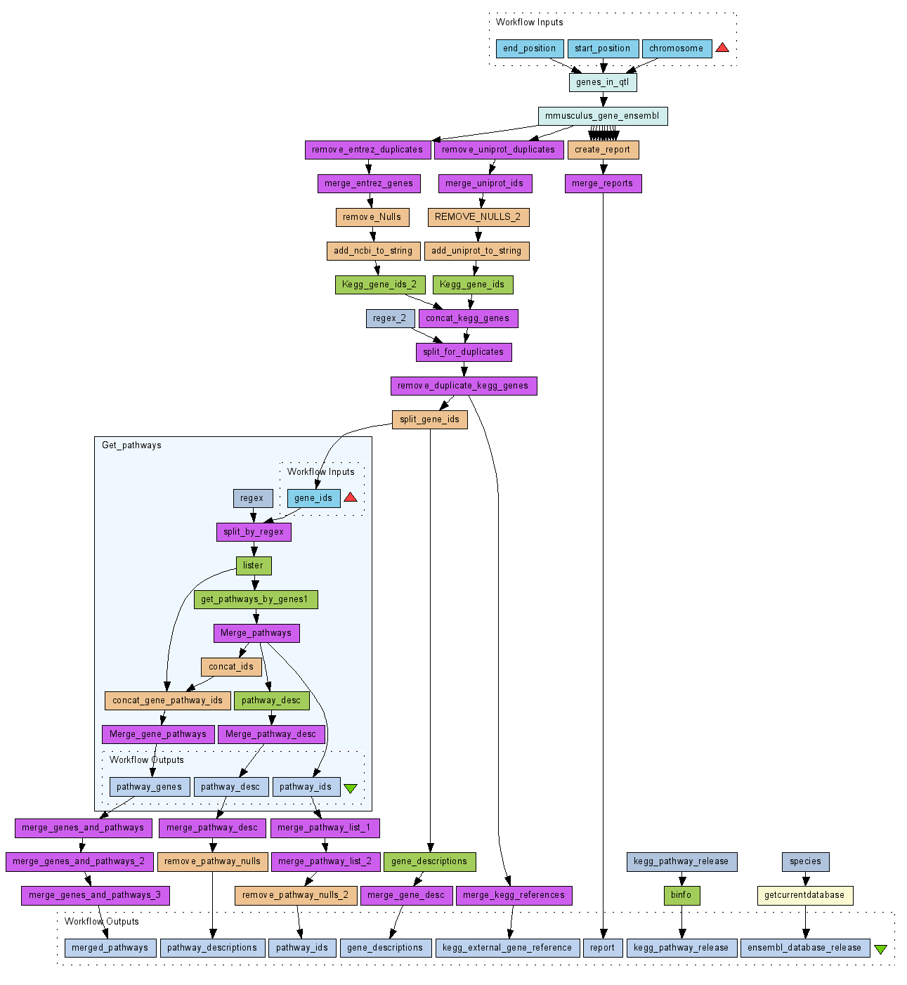
Get Genes in QTL
Get UniProt and Entrez ids
Cross-reference to KEGG gene ids
Get pathways per gene (KEGG)
Record Database versions
Notes:
The QTL to Pathway workflow
This is what one of the actual workflows looks like.
Not a very nice looking protocol.
It is not easy to follow for biologists, but, a biologist would not interact with the workflow.
Biologist would interact through a simplified interface, or, give it to a bioinformatician to run.

Slide 26
Trypanosomiasis Resistance Results
A gene was identified from analysis of biological pathway information
Daxx gene not found using manual investigation methods
Daxx was found in the literature, by searching Google for “Daxx and SNP”
Sequencing of the Daxx gene in Wet Lab (at Liverpool) showed mutations that is thought to change the structure of the protein
These mutations were also published in scientific literature, noting its effect on the binding of Daxx protein to p53 protein
p53 plays direct role in cell death and apoptosis, one of the Trypanosomiasis phenotypes
Notes:
Results
Preliminary results from this use case identified a key candidate gene Daxx
Daxx gene was not found using manual investigation methods, even though it took several months for them to do a “thorough” analysis
The gene was identified from analysis of biological pathway information and investigating it through the scientific literature
A paper by Yan et al, suggested Daxx as a potential candidate gene, based on SNP information
Sequencing of the Daxx gene in Wet Lab showed mutations that is thought to change the structure of the protein
Mutation was published in scientific literature, noting its effect on the binding of Daxx protein to p53 protein – p53 plays direct role in cell death and apoptosis, one of the Trypanosomiasis phenotypes

Slide 27
A Systematic Strategy for Large-Scale Analysis of Genotype-Phenotype Correlations: Identification of candidate genes involved in African Trypanosomiasis
Fisher et al., (2007) Nucleic Acids Research
MyGrid Taverna Workflows – Paul Fisher, Katy Wolstencroft
Manchester – Andy Brass, Helen Hulme, Catriona Rennie
ILRI – Steve Kemp, Fuad Iraqi, Morris Agaba, John Wambugu, Moses Ogugo, Jan Naessens
Roslin – Alan Archibald, Susan Anderson, Lawrence Hall
Liverpool – Harry Noyes

Slide 28
What main Taverna workbench service-types did this project use?
Web services
Shims (local workers and beanshells)
Biomart / Ensembl

Slide 29
How does this case study benefit from being carried out using workflows
Visualize task
Encapsulate concepts
Sharing / communication across project
Re-runnable! – During the course of our project, there were 2 major refinements of QTL location estimates, gradual addition of further samples and repeats, changes in choices of analysis of microarray (methods, cutoffs etc)

Slide 30

Usecase 2: Workflows on the Cloud: Scaling for National Service
Katy Wolstencroft, Robert Haines, Helen Hulme,
Mike Cornell, Shoaib Sufi, Andy Brass, Carole Goble
University of Manchester, UK
Madhu Donepudi, Nick James
Eagle Genomics Ltd, UK

Slide 31
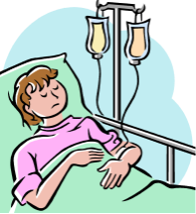

Motivation: Workflows for Diagnostics
NHS genetic testing, e.g. colon disease
Annotation of SNPs (Single Nucleotide Polymorphisms) in patient data, ready for interpretation by clinician.
Diagnostic Testing Today
Purify DNA. PCRs exons of relevant genes (MLH1, MSH2, MSH6).
Sequence, identify variants, classify: (pathogenic, not pathogenic, unknown significance etc.).
Writes report to clinician
Diagnostic Testing Tomorrow (or later today) uses whole genome sequencing
ANNOTATE, FILTER, DISPLAY
Next Gen Seq data
Variation data
New problem: How do we classify all the variants that we discover?
Notes:
Diagnostics is increasingly using nex gen seq methods – these are replacing sequencing of specific exons. The key difference is that the methods now usually look at a pre-decided set of genes, and check for presence of a set of “well known” variants. The new method results in many K of SNPs which must all be triaged. Example of where next gen gives benefit: Hereditary blindness >100 potential genes to look at. Less costly to NextGen than seq individual genes.

Slide 32
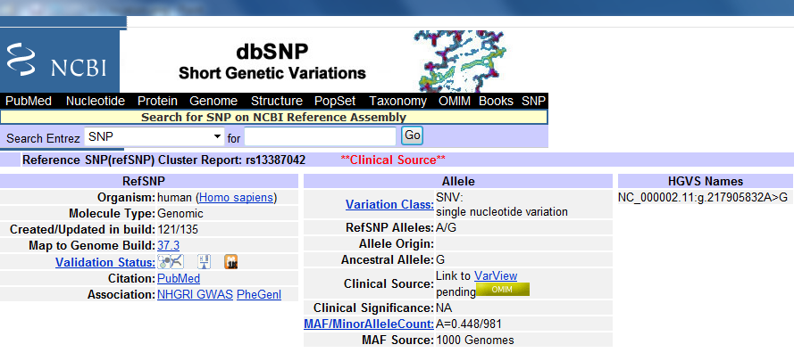
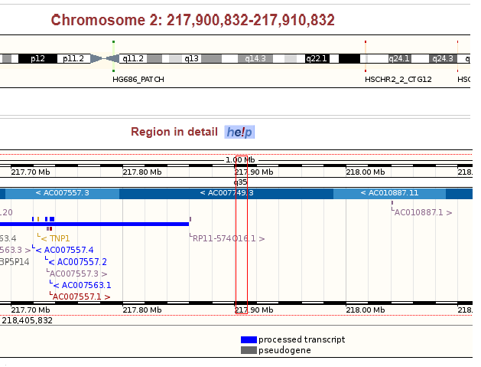
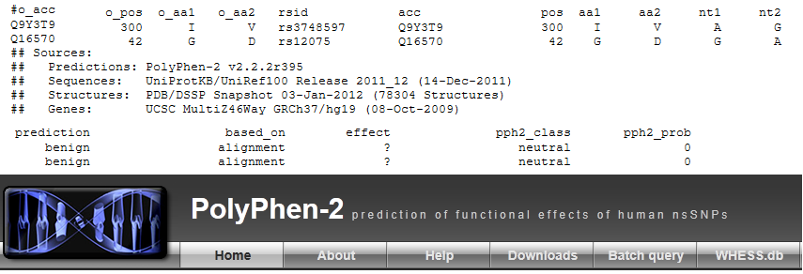
SNP annotation
Annotation task
Location, Gene, Transcript
Present in public databases, dbSNP etc
Missense prediction tool scores (SIFT, polyphen2 etc.)
Frequency in e.g. 1000 genome data
Conservation data (cross species)
Workflows are good for collecting and integrating data from a variety of sources, into one place
Notes:
Carole’s concept of “Workflows for Ensemble work”

Slide 33
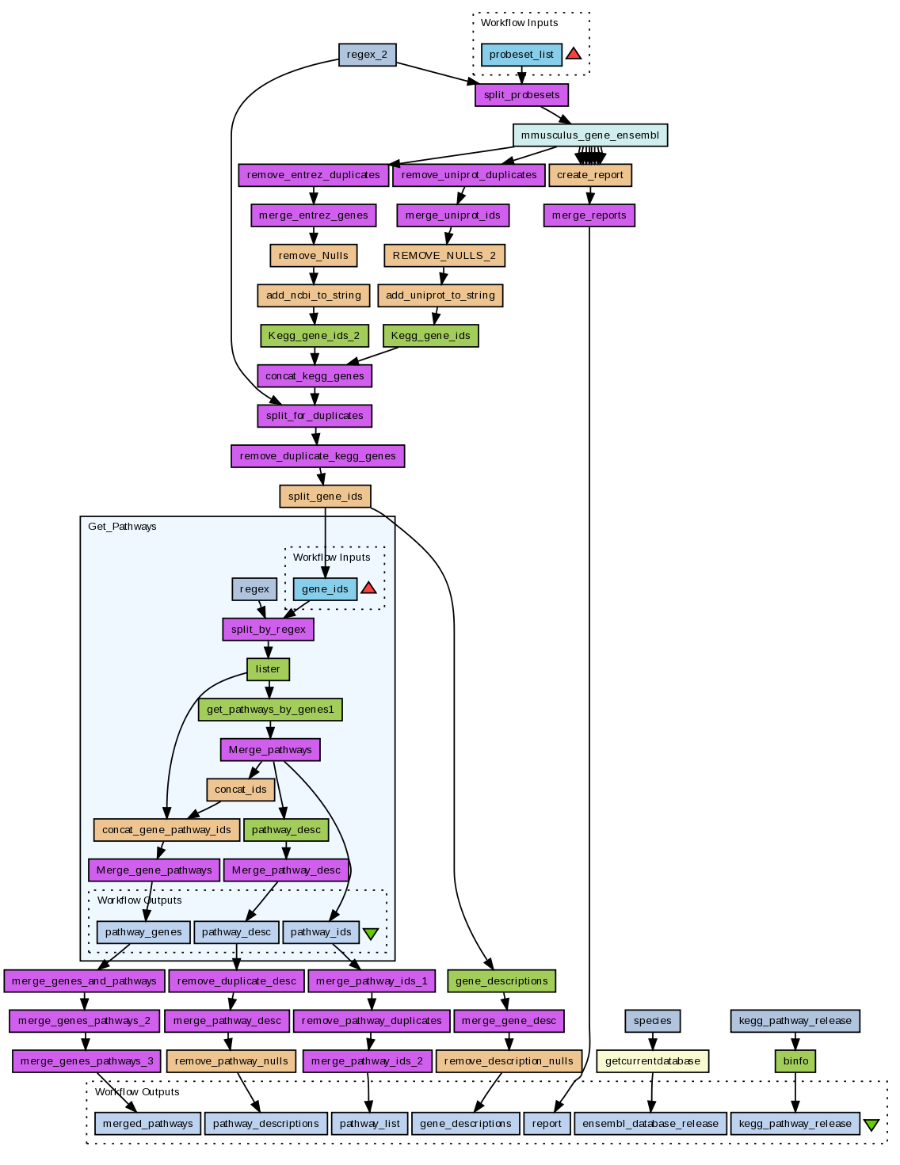
Taverna Workflows
Workflow management system
Sophisticated analysis pipelines
A set of services to analyse or manage data (either local or remote)
Automation of data flow through services
Control of service invocation
Iteration over data sets
Provenance collection
Extensible and open source

Slide 34
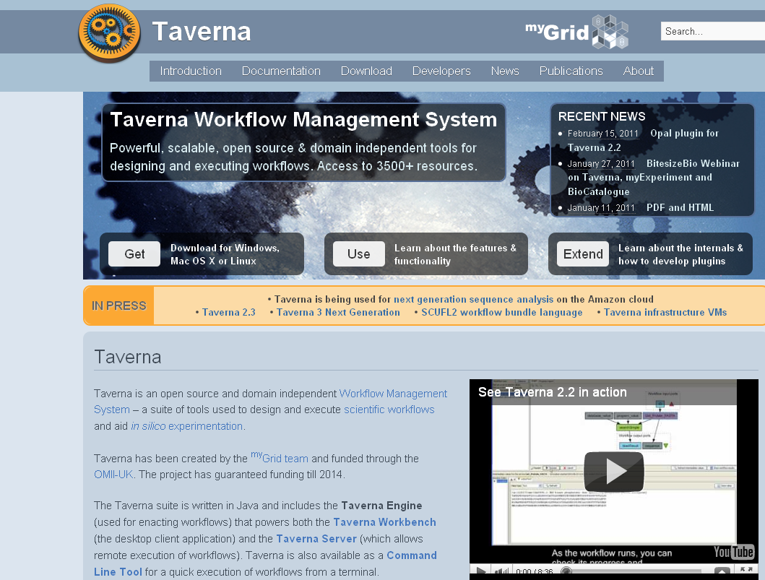
Taverna
http://www.taverna.org.uk/
Freely available
open source
Current Version 2.4
#80,000+ downloads
across version
Part of the myGrid Toolkit
Windows/Mac OS X/
Linux/unix
Nucleic Acids Res. 2006 Jul 1;34(Web Server issue):W729-32.
Taverna: a tool for building and running workflows of services.
Hull D, Wolstencroft K, Stevens R, Goble C, Pocock MR, Li P, Oinn T.
Notes:
34

Slide 35
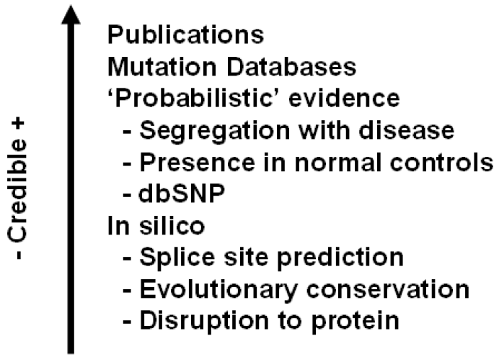
Variant classification
Easy to classify: Nonsense mutations. (Single base insertion causing frame shift in coding exon. Creation of stop codon).
Less easy: Synonymous mutations. Do they alter splicing?
Hard to classify: Missense (Non-synonymous mutations). Do they affect function or splicing?
In order to classify missense mutations, clinical scientists need to integrate data from a variety of sources, including prediction algorithims.
SOPs for classifying variants have been developed, e.g. CMGS/VKGL Guidelines for Missense Variant Analysis
Notes:
This slide is really to say: “Its complicated!” i.e. to provide motivation that a workflow would be a good thing for a) organizing the pipelines b) keeping track of provenance.
This slide should really be simplified with a diagram – I’ll try to make something better next week.
Mike’s notes on important considerations w.r.t. the various kinds of evidence:
Published evidence (can be wrong)
Has variant been classified in LSDB? (can be misclassified)
Presence in dbSNP/1000 genomes
Testing matched controls (for 95% chance of observing a variant with an allele frequency of 1 in 100 at least once you need to screen 298 chromosomes).
Co-occurrence (in trans) with known deleterious mutations (for BRCA1).
Co-segregation with the disease in the family
Functional assays
mRNA splicing
Bioinformatics – missense tools and splice site predictions.
Bayesian approaches to combining evidence being developed. May be gene specific.

Slide 36
SNP filtering / triage
Reduction of 80K data points to those potentially with clinical significance.
Criteria
Reduce to (disease)-specific gene list
Sense < Missense < Stop codon etc
Based on prediction tool scores
Frequency in population (based on 1000 genome data etc) (high frequency implies non deleterious)
Conservation across species (implies that change is deleterious)

Slide 37
Collecting Provenance data using workflows
Workflows are good for visualizing a problem, organizing pipelines, and aligning intent with implementation.
Workflows are good for collecting Provenance Data:
What were the parameters used to build the dataset
What versions of databases, genome assembly, machine
Where does each piece of evidence for/against pathogenicity originate from?

Slide 38
Ideal world
We “Cloudify” as much of possible of the current diagnostic workflow.
We add some more, for example:
depth of coverage
Extent of coverage (what was missed)
List of known pathogenics to check
Store description of what you did for databasing/sharing.

Slide 39
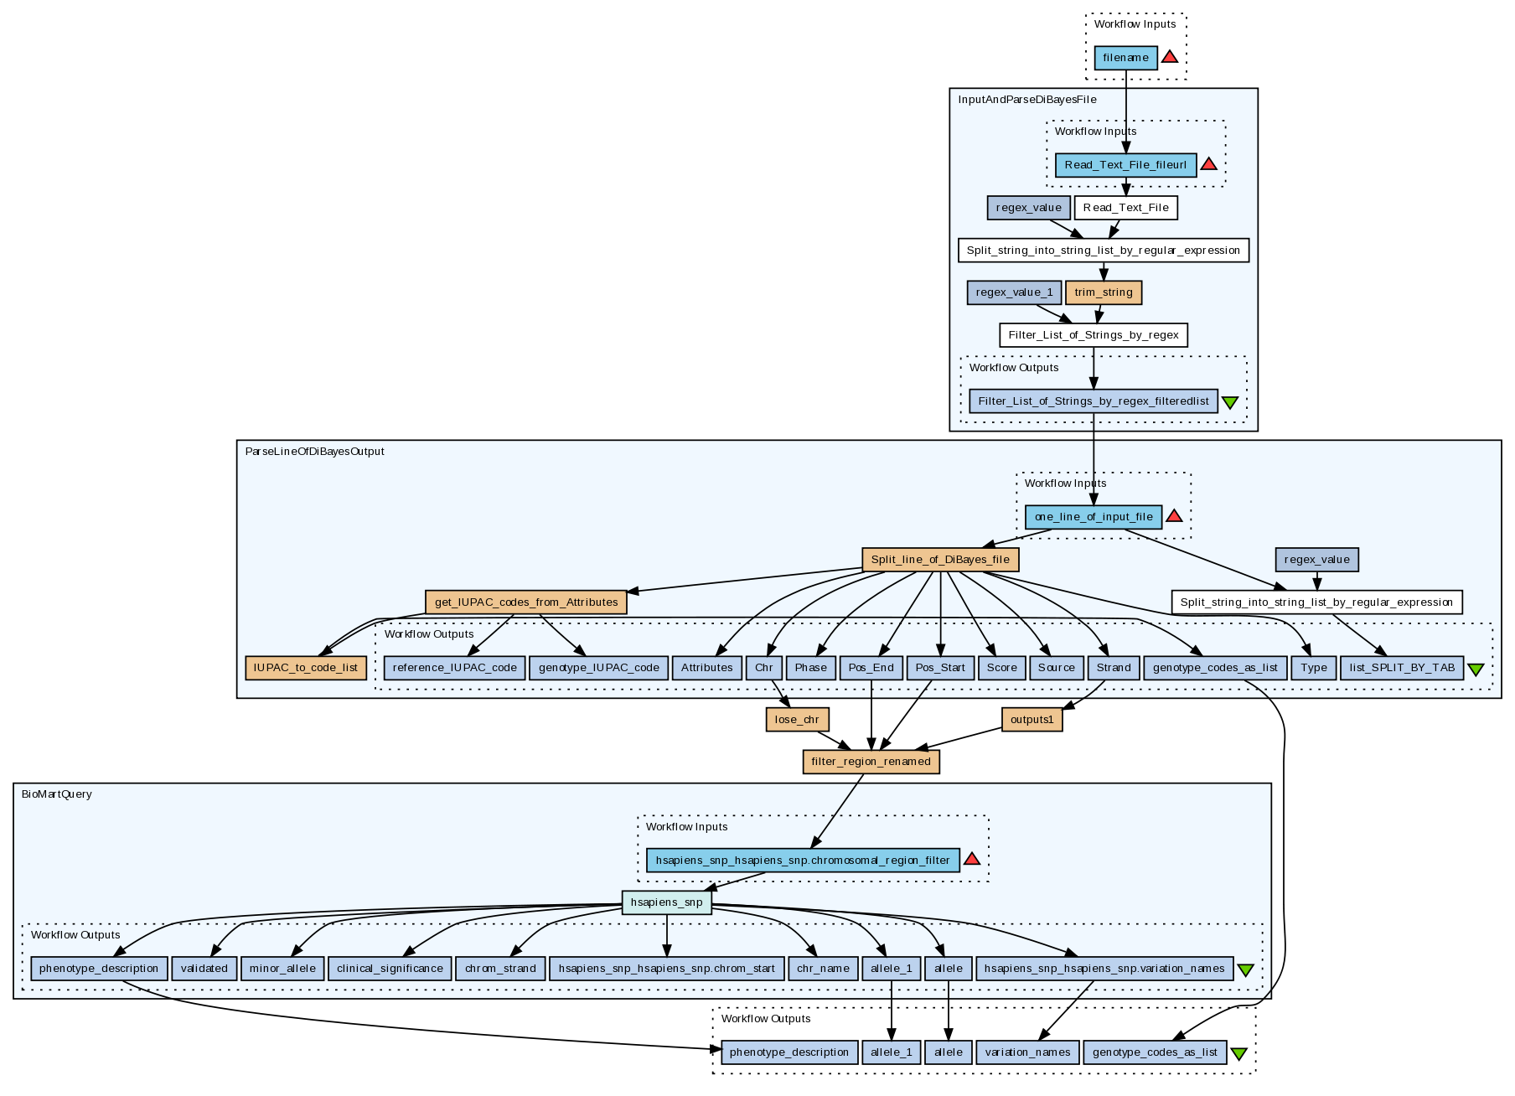
Workflow
Taverna’s “Tool Service” feature – used to wrap Perl scripts and other command line applications
Uses VEP (Ensembl)
Passes references to files

Slide 40

Architecture overview
All user interaction via web interface
User data stored in the Cloud
Data for all tools and Web Services stored in the Cloud
Input
SNPs
Web
interface
Storage (S3)
Ensembl (mySQL)
Cache
(S3)
Secure area
(OpenAM)
Results
Workflow engine
orchestrator
Common API
Taverna
Taverna Server
Application specific tools and Web Services
Taverna Server
Application specific tools and Web Services
Taverna Server
Application specific tools and Web Services
e-Hive
WS
WS
WS
Tool
Tool
other
Unified access to different workflow engines with our common REST API
Tools and Web Services for each workflow are installed together for easy replication
Notes:
OpenAM (http://www.forgerock.com/openam.html)
Not sure the “AM” actually stands for anything specific now.
It used to be called OpenSSO when Sun first created it (SSO means Single Sign-On)
Used for centralized authentication, authorization, entitlements and federation services
Which basically means user sign-on for what we are using it for.

Slide 41
The user’s view
Curated set of workflows
Designed, built and tested by domain experts
Quality assurance tested (if appropriate)
Workflows are presented as applications
The workflows themselves are hidden
Configured and run via a web interface
All user data stored securely in the Cloud
User separation
Workflows as a Service

Slide 42
Web interface: Overview
Upload input data
Configure workflow runs with
Input parameters
Uploaded data
Reused output data
Start workflow runs
Monitor workflow runs
View results preview
Download complete results

Slide 43
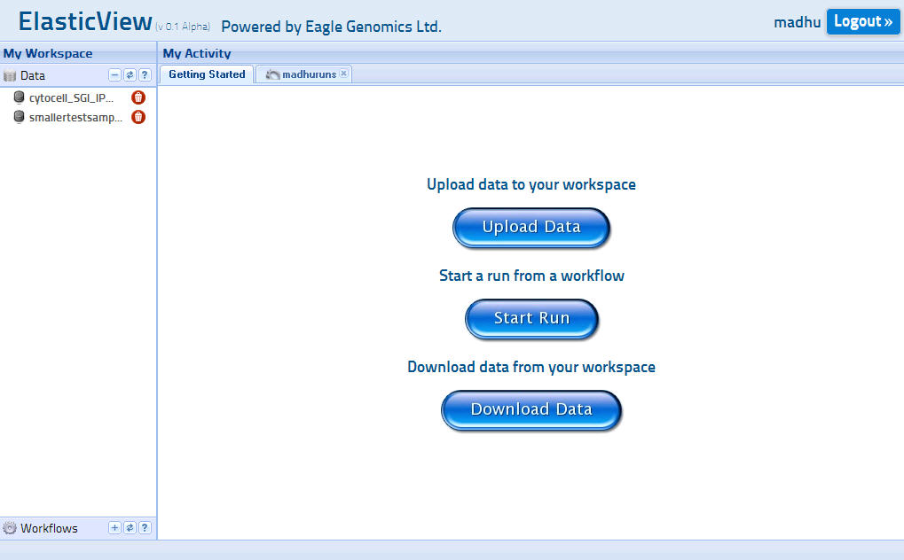
Web interface: Getting started

Slide 44
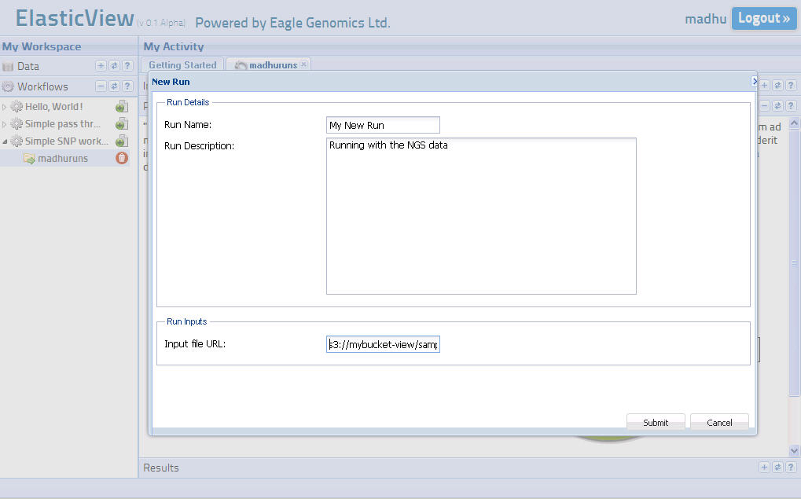
Web interface: Creating a Run

Slide 45
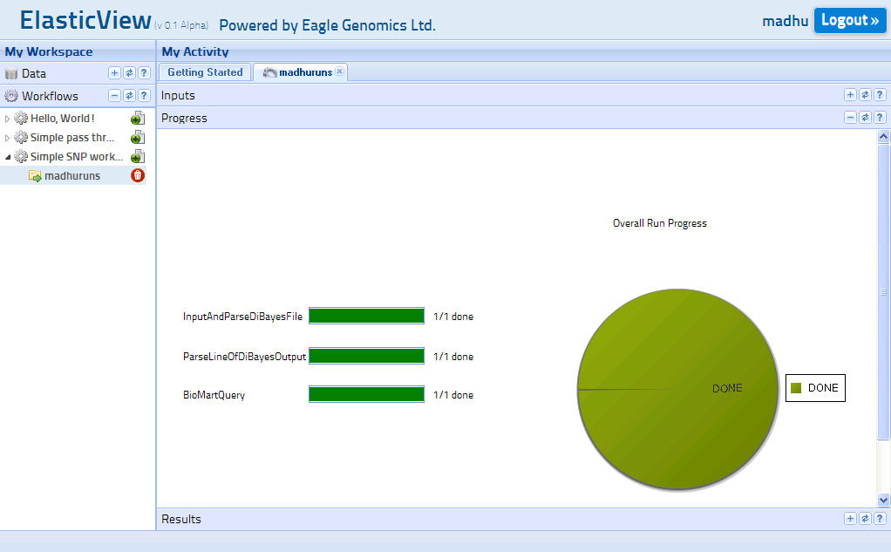
Web interface: Checking run progress

Slide 46
Workflow engine orchestration
Workflow engine
orchestrator
Orchestrator is workflow executor agnostic
Uses common API to:
List workflows
Configure runs
Start runs
Manage current runs
Status
Progress
Delete runs
Common REST API
e-Hive Interface
Taverna Interface
Cache
Engine specific APIs
e-Hive
Taverna

Slide 47
Additional Taverna functionality
Integration with Cloud infrastructure
AWS first
Read/write files securely to S3
Start and stop Cloud instances if required
Tool and Web Service scaling
Self-scaling
Released as part of Taverna 3
Notes:
AWS == Amazon Web Services (ie the Amazon Cloud)
S3 is Amazon’s Simple Storage Service
Taverna 3 should come end 2012

Slide 48






Acknowledgements/Partners
University of Manchester
Eagle Genomics
Technology Strategy Board
100932 - Cloud Analytics for Life Sciences
National Health Service
Amazon Web Services

Slide 49
What service types does this workflow use
Command line tool
Wrapping perl scripts
Pass variables by reference
Contrast with Use case 1:
Web services
Shims

Slide 50
Caveat!
Just because your workflow is repeatable / rerunnable, doesn’t mean its infallible
It can do something wrong – but at least its trackable
NHS – high importance of accountability:
Demonstrate compliance with approved protocols
Provenance – recording source of data and tools

Slide 51
What does Taverna add to this project
Provenance
Accountability
Scaling
Interface

