Slide 1
HELIO: Discovery and Analysis of Data in Heliophysics
Robert Bentley, John Brooke, André Csillaghy, Donal Fellows, Anja Le Blanc, Mauro Messerotti, David Pérez-Suárez, Gabriele Pierantoni, Marco Soldati
University College London, University of Manchester, Fachhochschule Nordwestschweiz, INAF, Trinity College Dublin

Slide 2
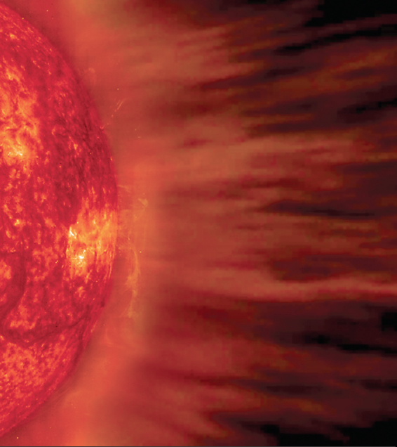
Heliophysics
Study of Sun’s “Atmosphere”
From Sun’s Surface to Interstellar Space
Phenomena Propagating through Plasma
Many types of phenomena
Many types of sources on Sun
Both Ground-Based and Orbital Instruments
Many ways of observing phenomena
Complex problem of locating instruments
Decades of Data Available
Searches are Usually at Least 4-Dimensional
Time and place are critical parameters
Notes:
What's this? the solar system, where our planet is... BUT! it's a big laboratory!! There is a lot of instruments all around... and Heliophysics study that. Problems? A lot!! things move everywhere, it is a lab where you have not control on when and where do things, because they just happen and you need to be in the right moment looking at the right position...

Slide 3
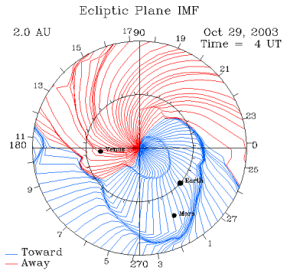
Propagation
Problem is Inherently Very Complex
Magnetohydrodynamic Simulations are Computationally Expensive
Not a Steady State Problem
Use Simple Approximations with Wide Error Bars

Slide 4
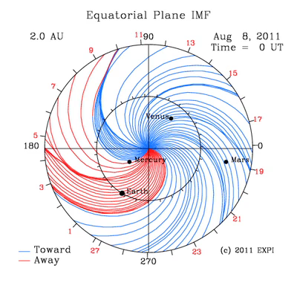
Propagation Model
Notes:
Problem is Inherently Very Complex
Magnetohydrodynamic Simulations are Computationally Expensive
Not a Steady State Problem
Use Simple Approximations with Wide Error Bars

Slide 5
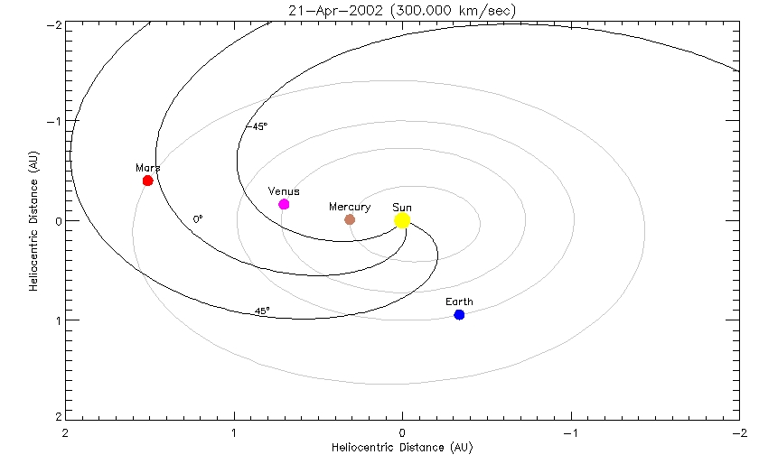
Parker Spiral
Notes:
Basic Shape of Solar Magnetic Field
Approximately an Arithmetic Spiral
“Spinning round with a hose”
Energetic Particles Follow Spiral like highway

Slide 6
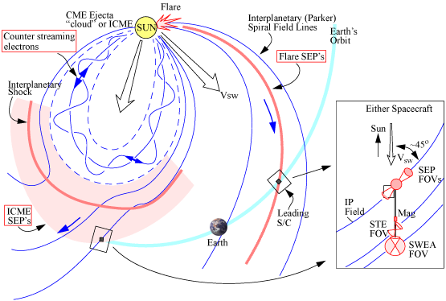
Event Detection
Notes:
Many Instruments can Only Detect Parts of Phenomena
High Flux Levels
Large Rates of Change

Slide 7
Data in Heliophysics
Data Made Available by Observatories
Observatories are both physical and virtual
Observatories responsible for basic data quality
Data in Several Major Categories
Key ones: images and time-series
Finding, Accessing and Understanding Data is Real Challenge
Big problem: could a particular instrument have possibly observed a phenomenon?
Notes:
Observatories are Physical and Virtual
Physical: collection of instruments grouped together, on Earth or in Space
Virtual: scientific collaboration that manages the data produced by the instruments

Slide 8
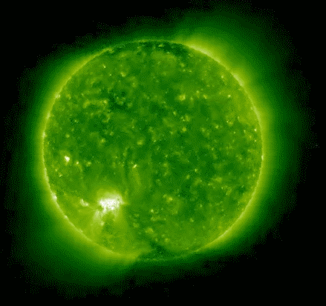
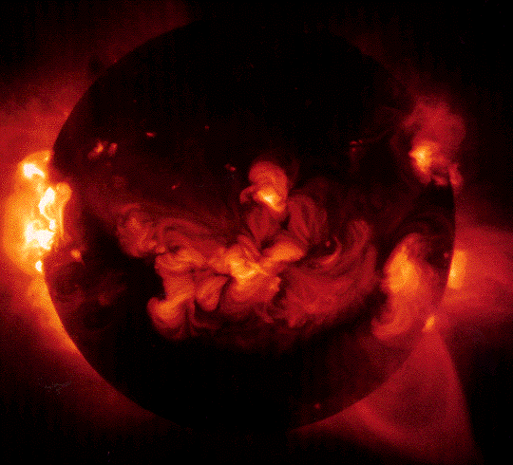
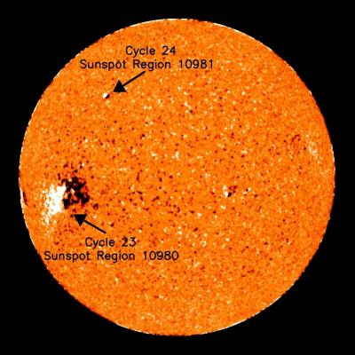
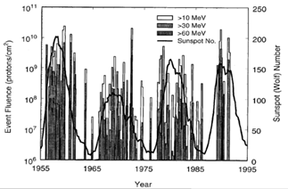
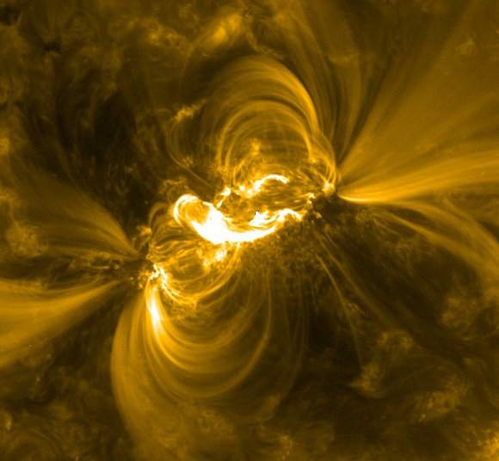
Data in Heliophysics
Many Types of Images
Different spectral ranges
Visible Light, Ultra-Violet, X-Ray, Gamma
Different parts of Sun viewed
Whole disk, partial disk, corona only
Earth not in plane of solar equator
Many Types of Time Series
Different types of particle flux
Uncharged particles, light charged particles (electrons), heavy charged particles (atomic nuclei)
Different types of field measurements
Notes:
Images: Extreme UV, Xray, visible (with sunspots identified), particle flux, solar flare

Slide 9
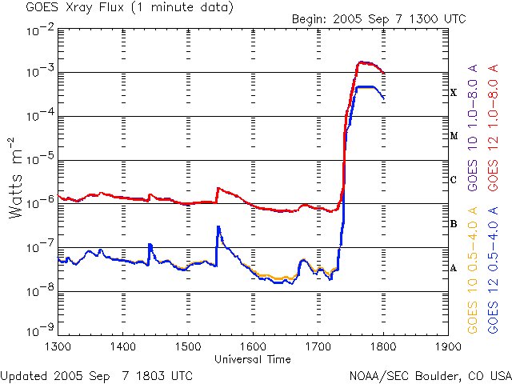
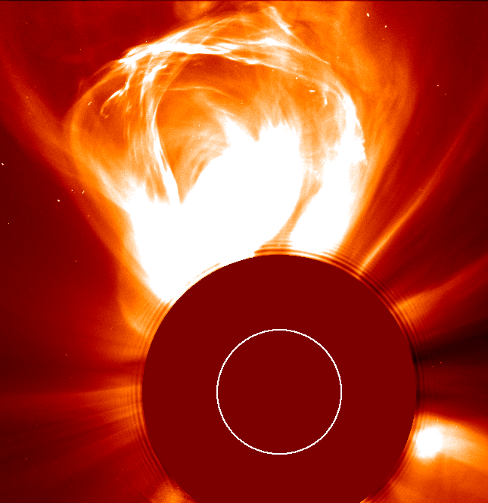
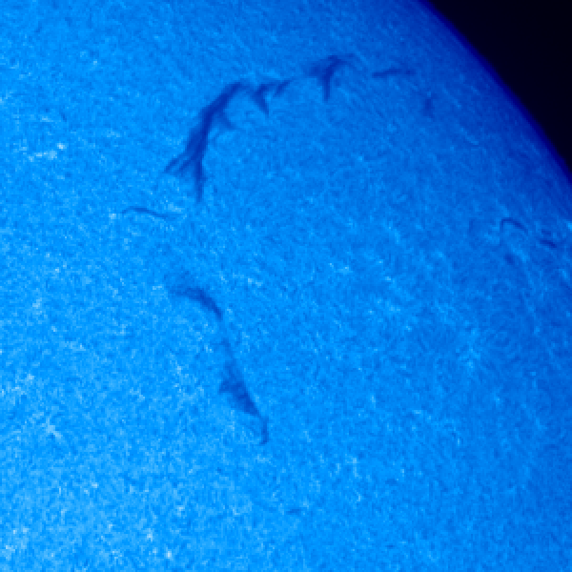
Semantics of Heliophysical Data
Three Major Categories of Observed Phenomena
Instantaneous events
Happen at a particular place and time
Enduring events
Observed by an instrument for a period of time
Solar features
Observed on sun; rotates with sun

Slide 10
Example Use of Heliophysical Data
Major Problem: Finding the Data
Find a relevant event or class of events for study
Find solar correlates for the event
Find events at other planets that could come from the same solar feature
Find raw data associated with events
Theorize about science that could lead to what was observed and what wasn’t
This is, of course, the real scientific problem
Find Interesting Event
Propagate
Find Solar Feature
Iterate
Propagate
Find Related Events
Find Data
Theorize
Notes:
Step 2: Feature on Sun, Physics close to solar surface is very complex, Multiple coordinate systems in use
Step 3: Search algorithm depends on what you’re looking for, and when you look depends critically on the instrument location, Data collected is very much imperfect; wide error bars
Step 4: Even this is not a simple problem…

Slide 11
HELIO Project
Project started in 2009
Apply eScience to Heliophysics
Tackle complex searching problem
Unified searchable catalogs
Advanced search via workflows
Derivation of new data via compute services
Distributed infrastructure
Replication
Master catalogs maintained by experts
Front end interface
All services also directly accessible via third-party tools
Community engagement
Help scientists to understand what we offer
Front End Portal
Catalog Services
Workflow Services
Compute Services
Databases
Workflow Repository
User Storage
Notes:
Search by observation time
Search by instrument location
Search by instrument/data type
Event and Feature descriptors, plus location of raw data

Slide 12


HELIO Catalogs
Catalog of Events
When did something happen
Catalog of Features
What things were seen on the Sun
Catalog of Observations
What observations were actually made
Catalog of Capabilities
What those observations were actually of
Catalog of Data
What URL provides the real data

Slide 13
HELIO Workflows
Combine Searches over Specific Catalogs to Achieve Wider Goal
Metadata steps
Searches of catalogs
Computational steps
Apply event propagation model
Convert coordinate systems
Data steps
Download and analyze
Limit to as small a set of data as practical
Built using Taverna
Execute using Taverna Server
Notes:
This workflow does a correlated query between particular types of solar features and events; the databases in question have completely different ways of being built and are hosted in different locations

Slide 14
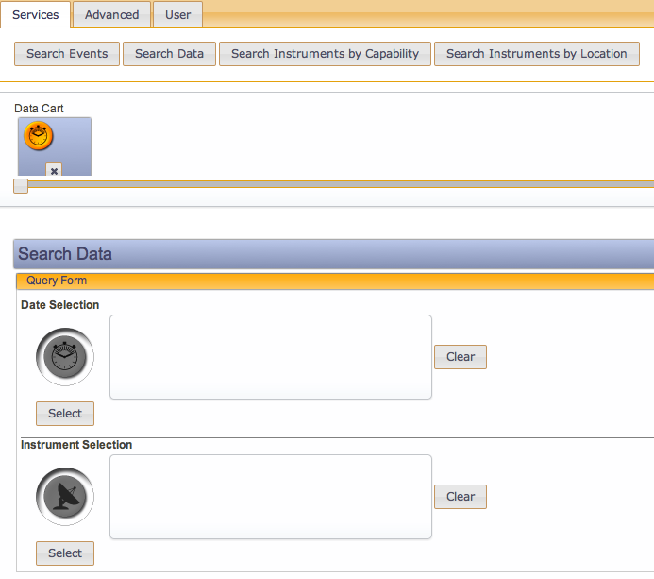
HELIO Front-End Portal
Portal that Organizes Searches
Guides users through searches
Stores search results as tables
Integrated access to data artifacts
Quick Previews
Data thumbnails
“Situational Awareness” for planetary (and instrument) locations

Slide 15
Future Work
More User Engagement
Help them to start working with lots of data
Improved Integration of Workflows with Portal
More Interoperation with Planetary Science
Many techniques applicable to study of solar system
Planets, asteroids, comets, …
More Interoperation with Astronomy
Techniques for handling high-dimensionality data
http://www.helio-vo.eu/

