Slide 1
Introduction to Workflows with Taverna and myExperiment
Aleksandra Pawlik
University of Manchester
materials by Katy Wolstencroft and Aleksandra Pawlik
Cranfield, 22nd January 2015
http://www.taverna.org.uk/
This work is licensed under a
Creative Commons Attribution 3.0 Unported License
Notes:
1

Slide 2
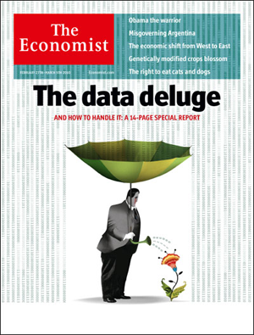
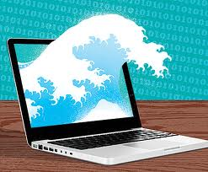
Data Deluge
‘Omics data
Next Gen Sequencing
eGovernment
World bank data
Climate change data
Large scale physics
Large Hadron collider
Astronomy
Notes:
2

Slide 3
Lots of Resources
NAR 2014: 1552 databases Genbank 2014-04: 172 million sequences, 162 billion basepairs WGS 2014-04: 774 billion basepairs
Notes:
3
Well over 200 from there.
139 different database for biopathways alone.
Lincoln Stein describes it a as a bionation – like italy in the 19th Century.

Slide 4
Next Generation Sequencing
2008-2012: 1000 Genome Project
A Deep Catalog of Human Genetic Variation
2009-: Genome 10k project
A genomic zoo—DNA sequences of 10,000 vertebrate species, approximately one for every vertebrate genus.
2012-: Human Microbiome Project
Characterise the microbial communities found at several different sites on the human body
Notes:
In November 2008 Elaine Mardis of Washington University in St. Louis and colleagues published the complete genome sequence of an individual with acute myeloid leukemia. Coming just a few years after the decade-long, multibillion dollar Human Genome Project, the paper was remarkable on several levels. For one thing, the team sequenced two human genomes, both cancerous and normal, some 140 billion bases in all. More impressive, though, was what the study omitted: the 50 human genomes Mardis sequenced that year (albeit not as deeply) for the 1,000 Genomes Project. "It's like a whole new world," she says. Welcome to the sequencing frontier.
4

Slide 5
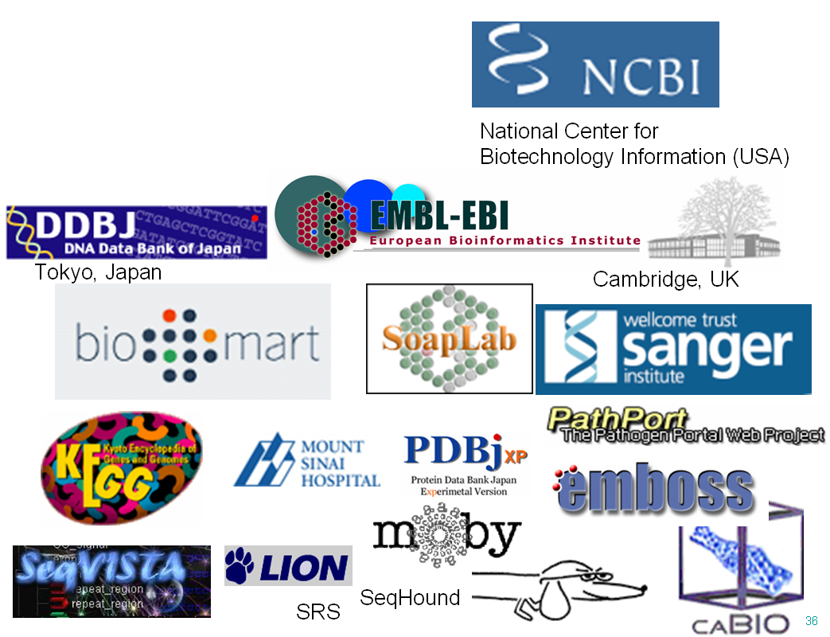
Where is the data?
Repositories run by major service providers (e.g. NCBI, EBI)
Local project stores
Static web pages
Dynamic web applications
FTP servers (!)
Inside PDFs ☹
Web Services ☺
Notes:
5

Slide 6
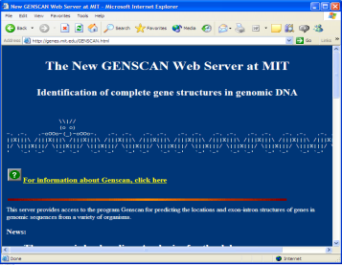
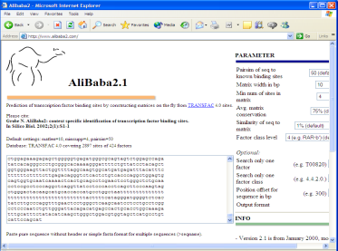
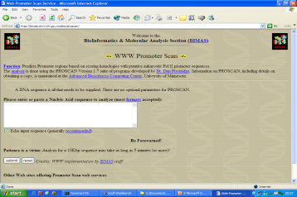
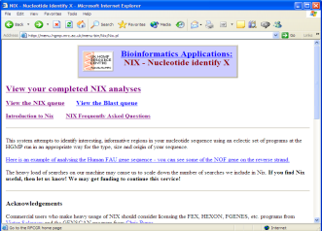
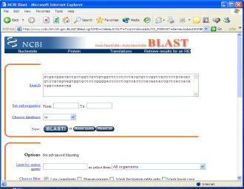
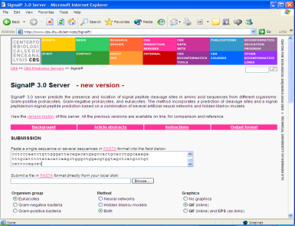
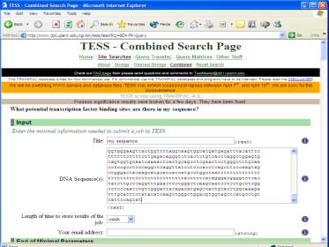
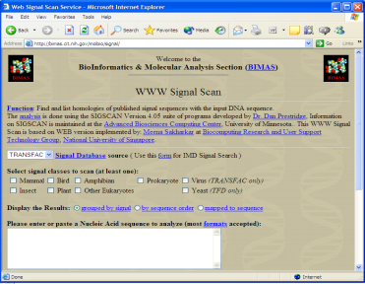
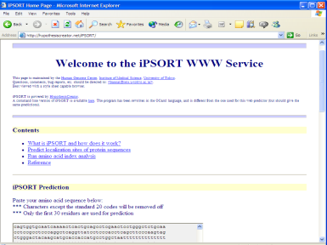
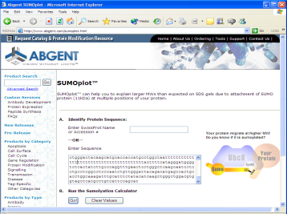
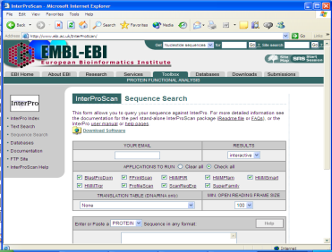
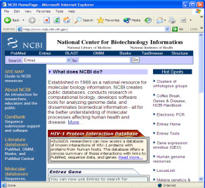
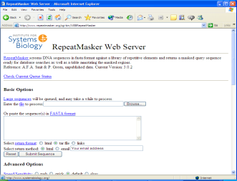
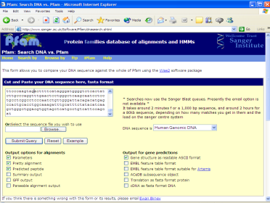
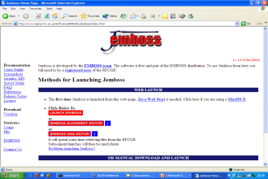
The implicit workflow
Bioinformatics research combines:
Data resources (public and private)
Computational power (standard and custom)
Researchers and collaborators
12181 acatttctac caacagtgga tgaggttgtt ggtctatgtt ctcaccaaat ttggtgttgt 12241 cagtctttta aattttaacc tttagagaag agtcatacag tcaatagcct tttttagctt 12301 gaccatccta atagatacac agtggtgtct cactgtgatt ttaatttgca ttttcctgct 12361 gactaattat gttgagcttg ttaccattta gacaacttca ttagagaagt gtctaatatt 12421 taggtgactt gcctgttttt ttttaattgg gatcttaatt tttttaaatt attgatttgt 12481 aggagctatt tatatattct ggatacaagt tctttatcag atacacagtt tgtgactatt 12541 ttcttataag tctgtggttt ttatattaat gtttttattg atgactgttt tttacaattg 12601 tggttaagta tacatgacat aaaacggatt atcttaacca ttttaaaatg taaaattcga 12661 tggcattaag tacatccaca atattgtgca actatcacca ctatcatact ccaaaagggc 12721 atccaatacc cattaagctg tcactcccca atctcccatt ttcccacccc tgacaatcaa 12781 taacccattt tctgtctcta tggatttgcc tgttctggat attcatatta atagaatcaa
Notes:
6

Slide 7
What that means for Bioinformatics
Sequential use of distributed tools
Incompatible input and output formats
Challenging to record/reproduce/tweak
parameter selections
service selection
results of each step
OK for one gene or one protein, but what about 10,000?
Analysing large data sets requires programmatic help

Slide 8
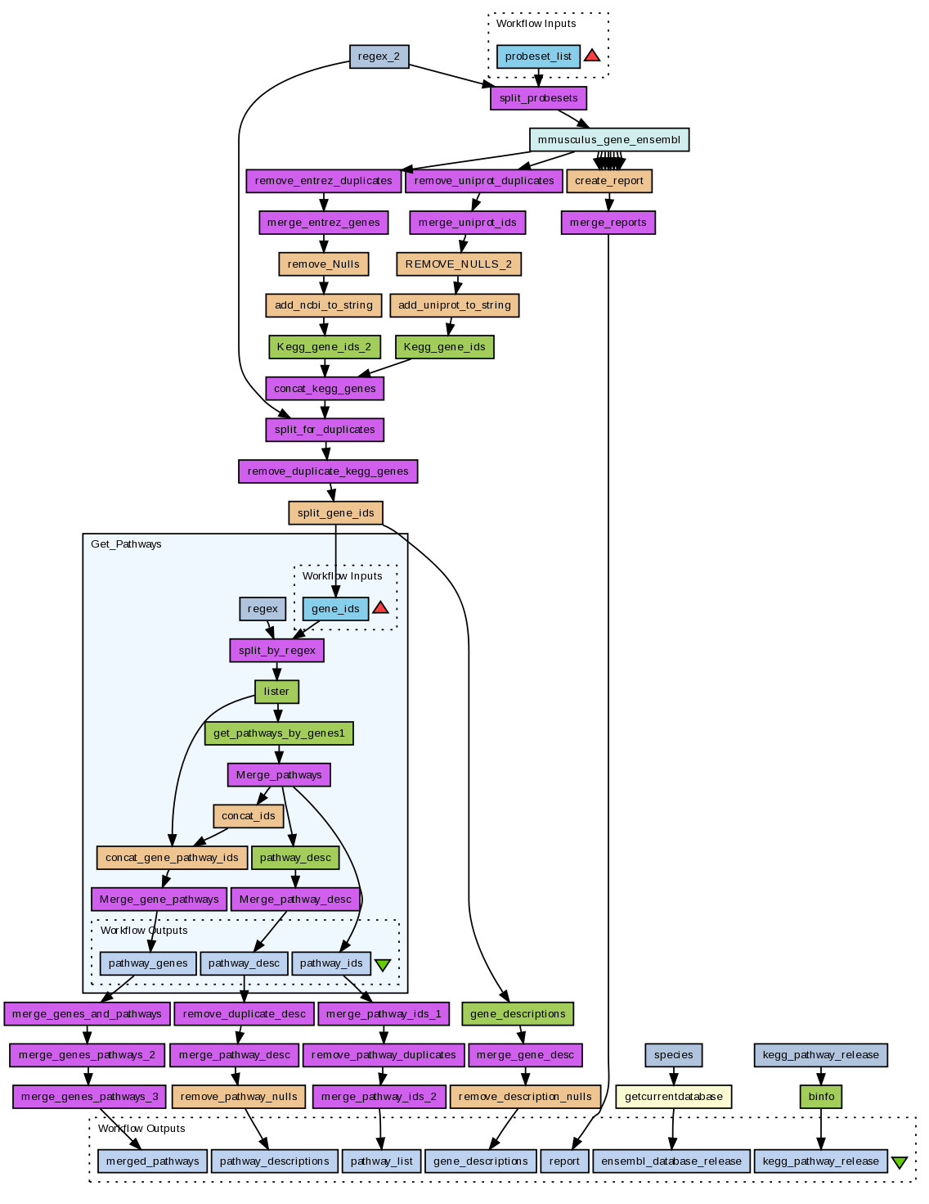
Workflow as a Solution
Sophisticated analysis pipeline
Graphical representation of executable analysis
Combine a set of services to analyse or manage data (local or remote)
Data flow from one service (boxes) to the next (connected with arrows)
Iteration – process multiple data items
Automation – rerun workflow

Slide 9
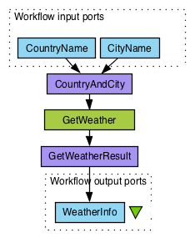
Example Taverna Workflow
Workflow: Get the weather forecast of the day given the city and the country
Green box is a Web Service
Purple boxes are local XML services to assemble/ extract XML
Blue boxes are workflow input and output ports
Arrows define the direction of data flow

Slide 10
Workflows as a solution
Flow of data from one tool to the next is automatic – just connect inputs and outputs
Incompatibilities overcome in the workflow with helper services (shims)
Allowing new tool combinations
Workflow engine records parameter values and algorithms – provenance
Workflows can include data integration and visualization
Iteration over large data sets automatic – ideal for high throughput analysis (e.g. omics)

Slide 11
Reproducible Research
Preventing non-reproducible research
An array of errors
http://www.economist.com/node/21528593
Duke University, 2006 - Prediction of the course of a patient’s lung cancer using expression arrays and recommendations on different chemotherapies from cell cultures – reported in Nature Medicine
3 different groups could not reproduce the results and uncovered mistakes in the original work
Notes:
ANIL POTTI, Joseph Nevins
Badly labelled experiments
Shifts in expression values and the genes they related to
Doesn’t guard against deliberate fraud, but it makes it harder to commit – Diederik Stapel
11

Slide 12
If the Analyses were done using Workflows.....
Reviewers could re-run the in-silico experiments and see results for themselves
Methods could be properly examined and criticized by inspecting the workflow
Mistakes and opportunities could be pinpointed earlier
Notes:
12

Slide 13
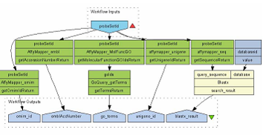
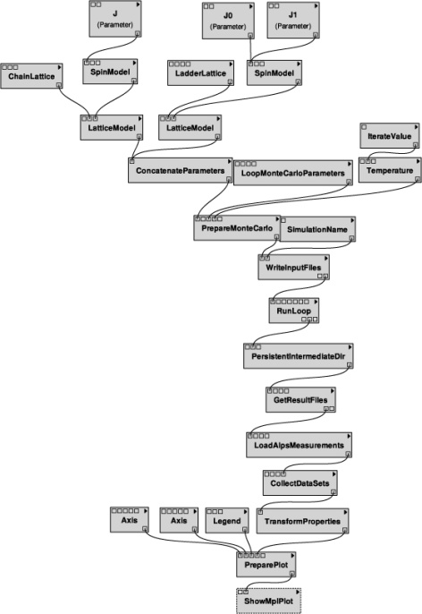
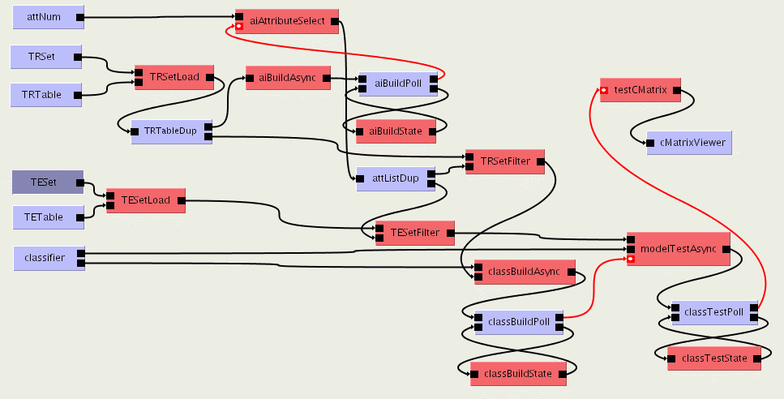
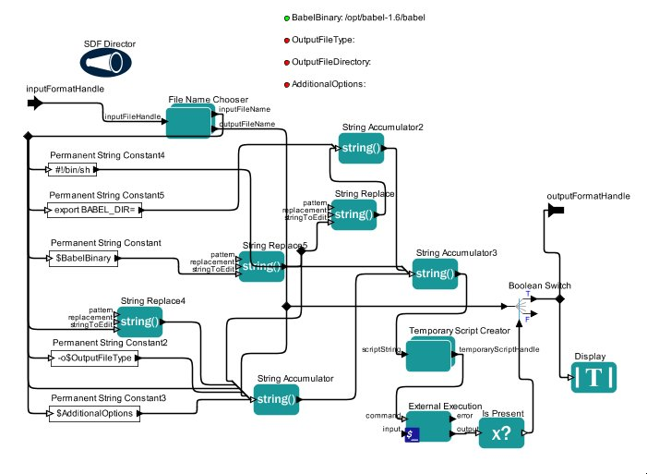
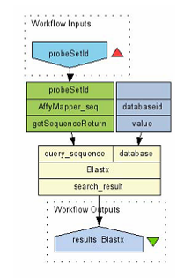
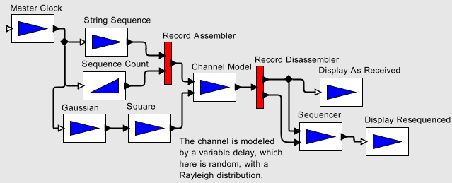
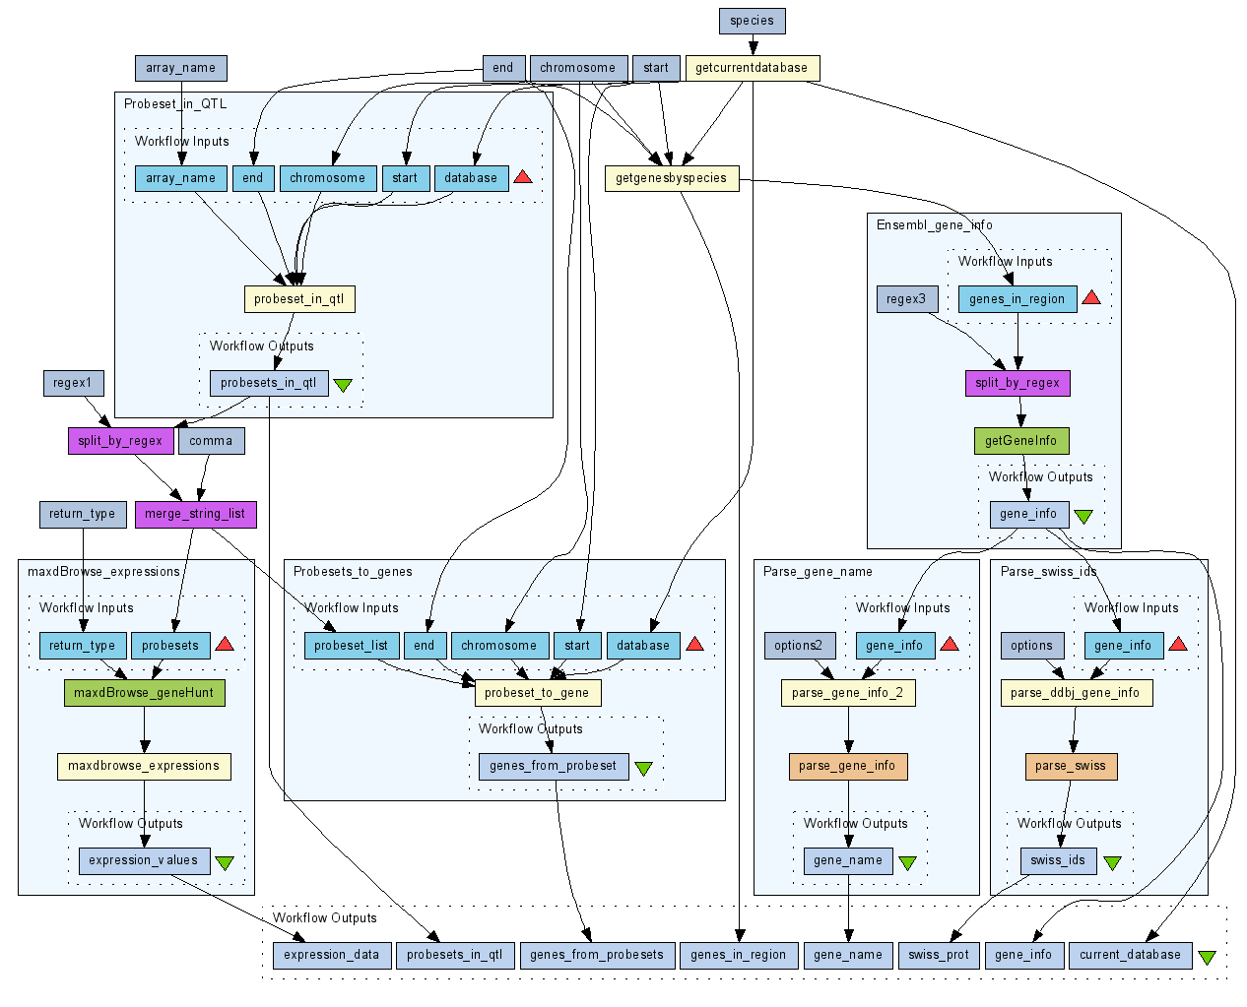
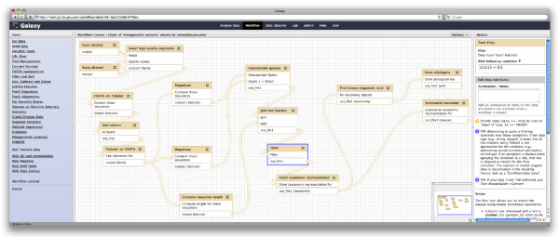
Different Workflow Systems
VisTrails
Kepler
Triana
Ptolemy II
Taverna
BPEL
Pipeline Pilot
Galaxy
Notes:
13
13
13
Over 400 taverna workflows publicly available.
Combine different formalisms in one system?
E.g. a dataflow Kahn network and a central- clock based calculus
Kepler logo

Slide 14
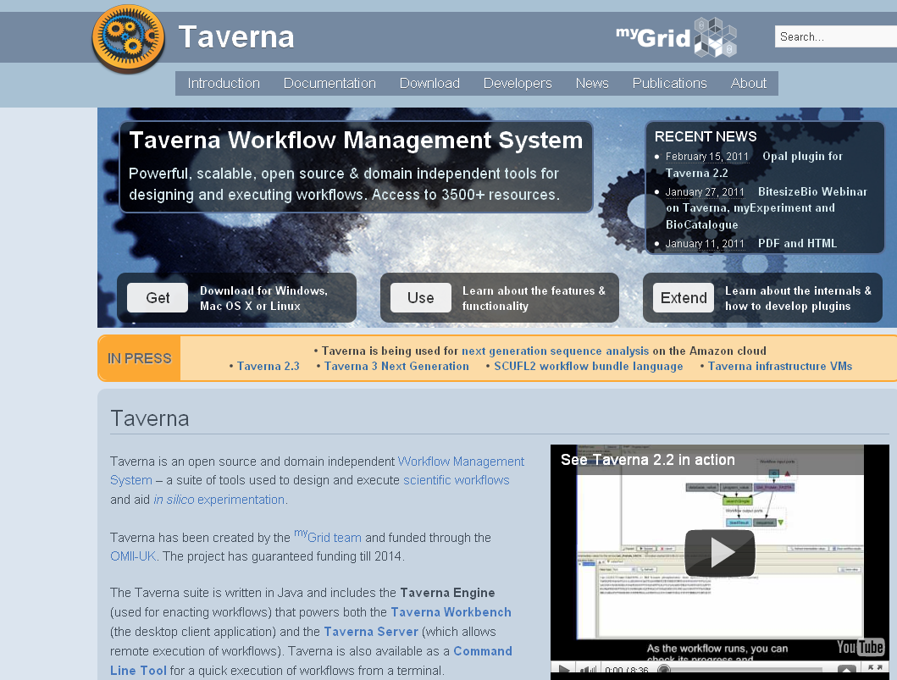
Taverna Workbench
http://www.taverna.org.uk/
Freely available,
open source
80,000+ downloads
across versions
Installers for Windows, Mac OS X, Linux
Current version: 2.5.0
Wolstencroft et al. (2013): The Taverna workflow suite: designing and executing workflows of Web Services on the desktop, web or in the cloud”, Nucleic Acids Research, 41(W1): W557-W561. doi:10.1093/nar/gkt328
Notes:
14
2001, run by manchester and oxford

Slide 15
Taverna Workflow System
http://www.taverna.org.uk
History:
2003: Taverna 0.1 (300 downloads)
2014: Taverna 2.5.0 (5100 downloads)
Products:
Taverna Workbench
Taverna Server
Taverna Command line
Taverna Online
Taverna Player
Plugins and integrations
Notes:
15
15

Slide 16
Taverna editions and extensibility
Taverna is a generic workflow system that can be extended by plugins and customized for use in different domains.
The Taverna editions are pre-built downloads of Taverna with plugins for the most popular domains.
Core
Astronomy
Bioinformatics
Biodiversity
Digital Preservation
Enterprise
http://www.taverna.org.uk/download/workbench/2-5/
Notes:
16
16

Slide 17
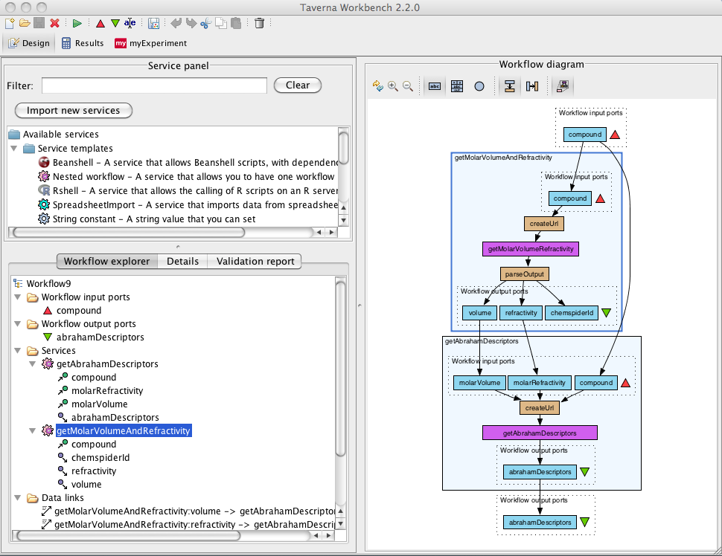
Taverna Workbench
Workflow engine
to run workflows
List of services
Construct and
visualise workflows
Web Services
e.g. KEGG
Programming
libraries
e.g. libSBML
Notes:
17

Slide 18
Using Tools and Services from Taverna workflows
Web Services
WSDL
REST
Data services
BioMart
Local scripts:
R
Beanshell
Command line (e.g. Python, Perl)
Other workflows
And more..... Add your own!
Notes:
18
18

Slide 19
What are Web Services?
Web Services: HTTP-based programmatic access (API). Instead of “GET me the web page http://example.com/cat-pics”, Web Services allow “GET me a genome sequence http://example.com/gene/WAP_RAT”
Connect to and use remote services from your computer in an automated way
NOT the same as services on the web (i.e. forms that shows results as a web page)
Notes:
19

Slide 20
Who Provides the Services?
Open domain services and resources
Taverna accesses thousands of services
Third party – we don’t own them – we didn’t build them
All the major providers
NCBI, DDBJ, EBI …
Enforce NO common data model.
Notes:
20
20

Slide 21
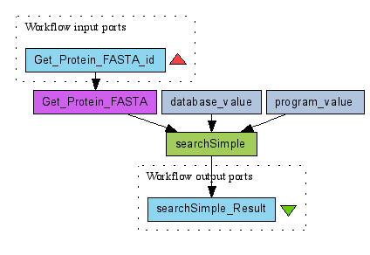
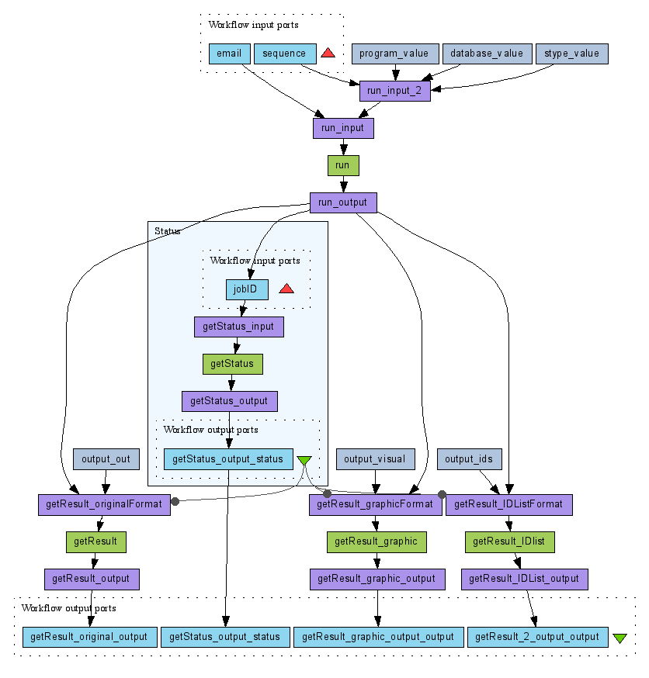
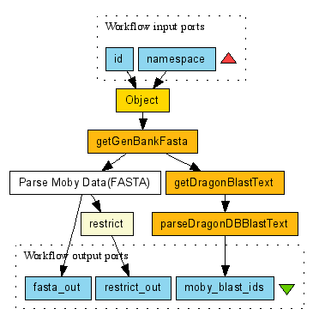
How do you use the services?
Simple WSDL
services
BioMoby Semantic
Services
Asynchronous services (Submit, Wait, Fetch)
Notes:
## change biomoby for sadi

Slide 22
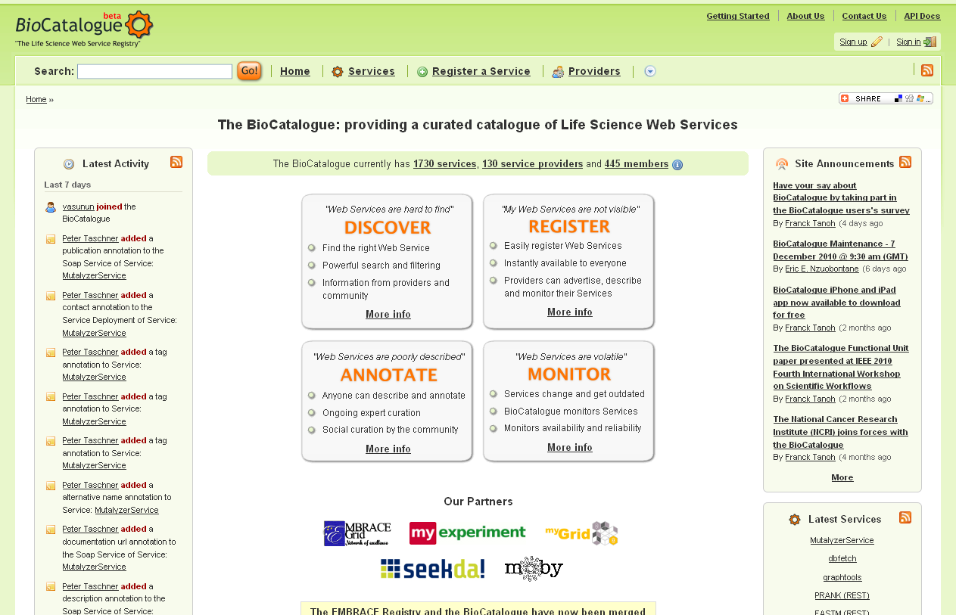
Notes:
22

Slide 23
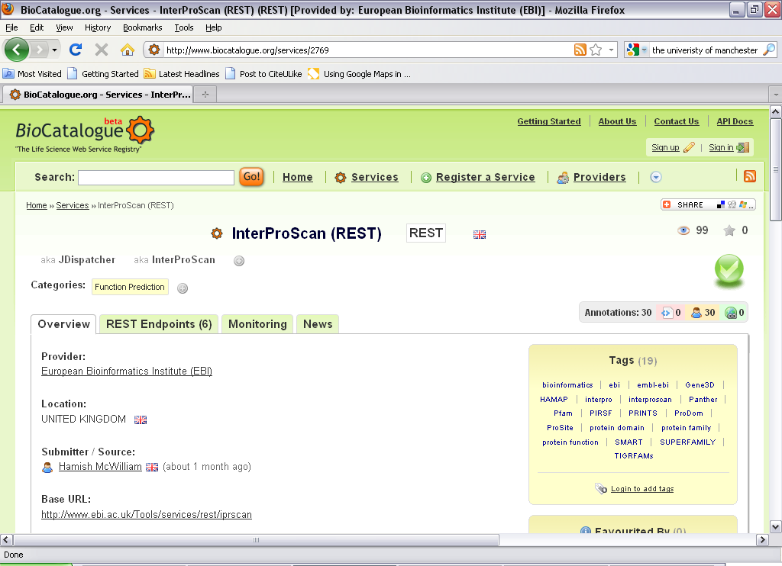
Monitoring
Provider
Tags
Submitter
Service Description

Slide 24
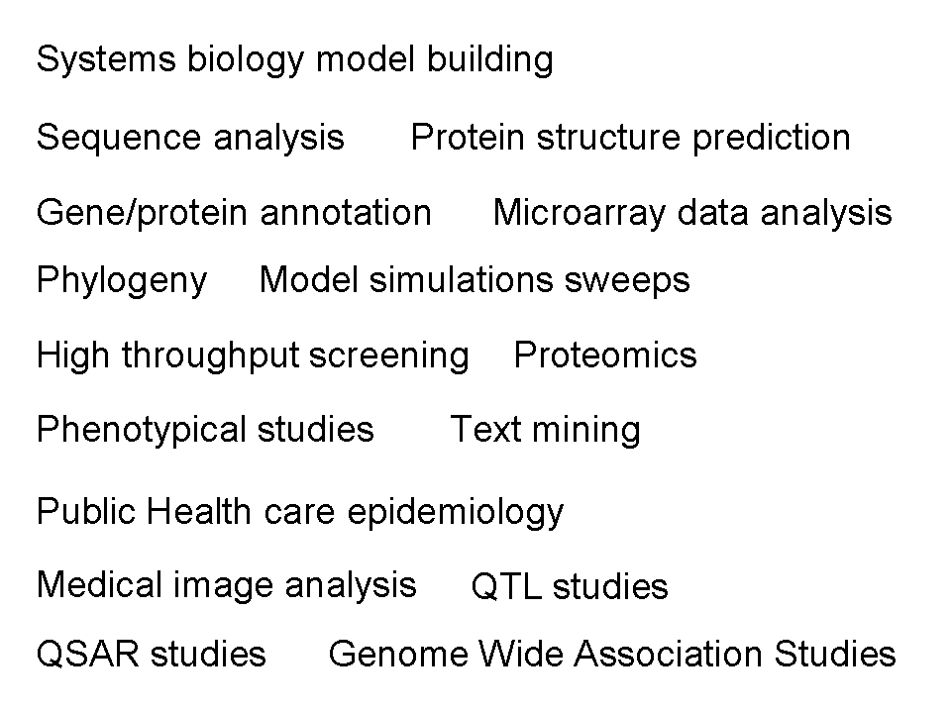
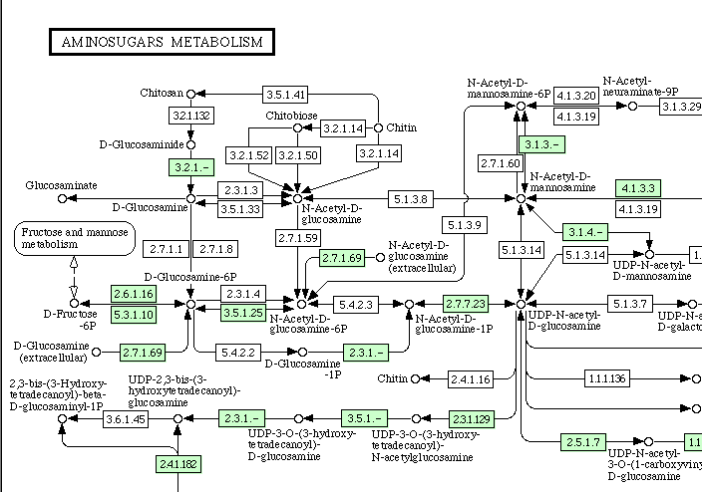
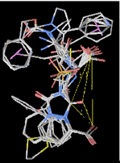
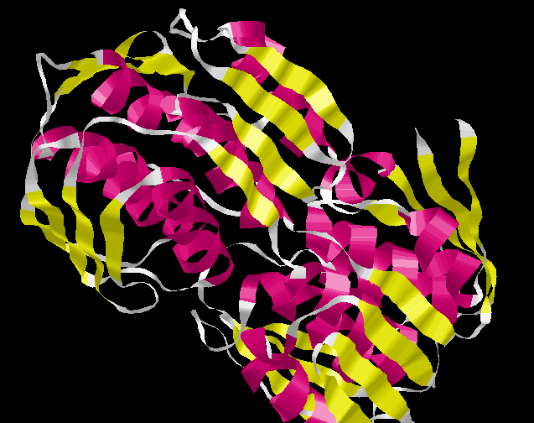
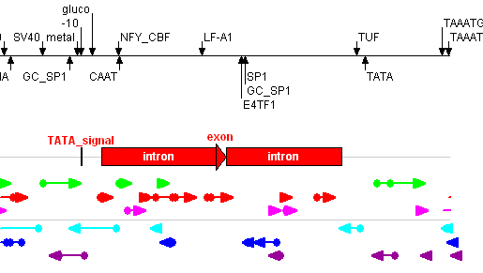
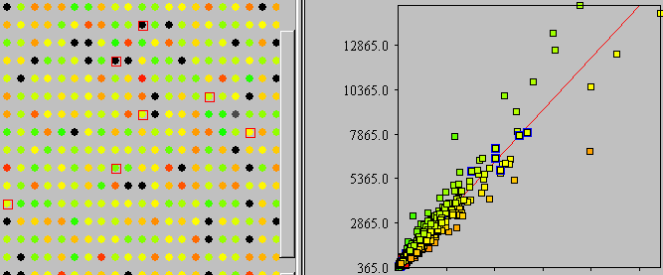
What do Scientists use Taverna for?
Astronomy
Music
Meteorology
Social Science
Cheminformatics
Notes:
24

Slide 25
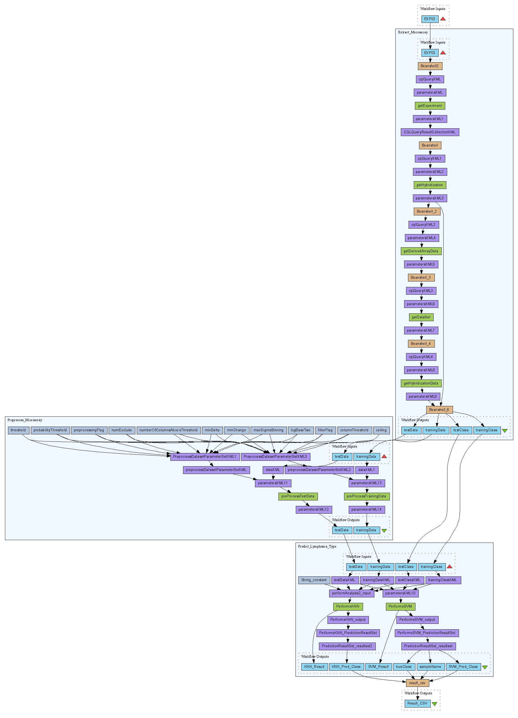
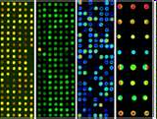
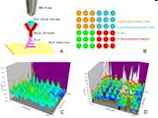
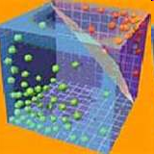
Research Example
Lymphoma Prediction Workflow
caArray
MicroArray from
tumor tissue
Use gene-expression patterns associated with two lymphoma types to predict the type of an unknown sample.
Microarray
preprocessing
Lymphoma
prediction
Wei Tan Univ. Chicago
GenePattern
Ack. Juli Klemm, Xiaopeng Bian, Rashmi Srinivasa (NCI)
Jared Nedzel (MIT)
Notes:
25

Slide 26
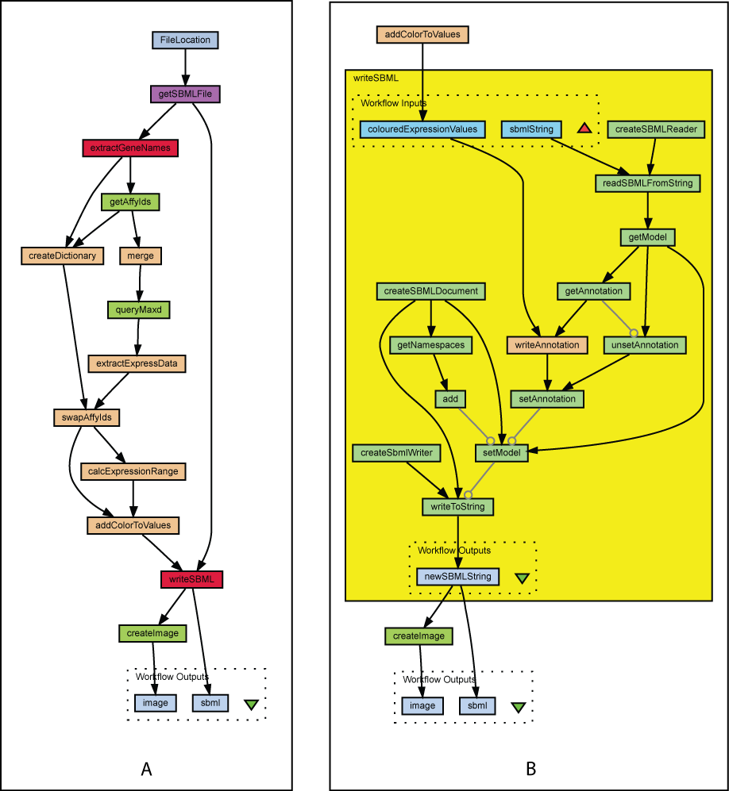
Systems Biology Data Integration
Read enzyme names from SBML
Query maxd database using enzyme names
Calculate colours based on gene expn level
Create new SBML model with new colour nodes
Mapping transcriptomics data onto SBML models
Peter Li, Doug Kell, U Manchester

Slide 27
Workflows are …
... records and protocols (i.e. your in silico experimental method)
... know-how and intellectual property
... hard work to develop and get right
…..re-usable methods (i.e. you can build on the work of others)
So why not share and re-use them
Notes:
27

Slide 28
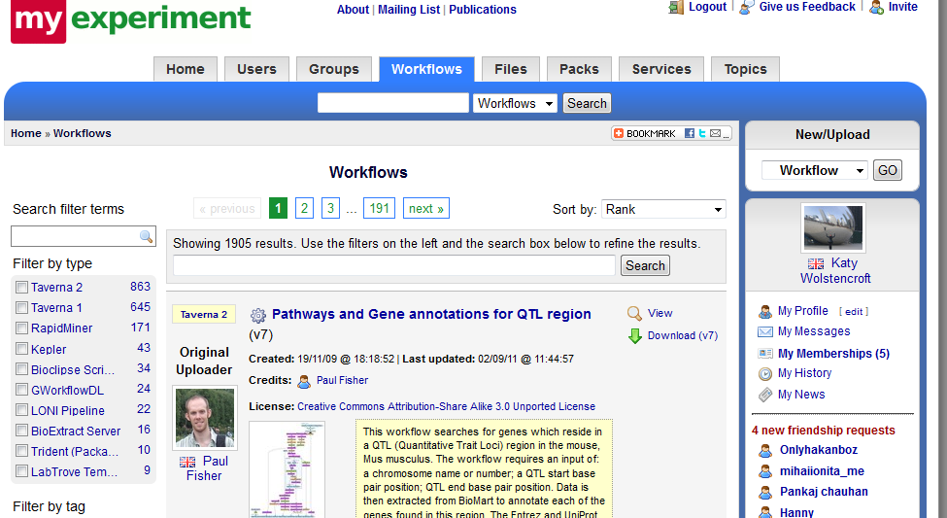
Workflow Repository
Notes:
28
28
### new screenshot required

Slide 29
Just Enough Sharing….
myExperiment can provide a central location for workflows from one community/group
myExperiment allows you to say
Who can look at your workflow
Who can download your workflow
Who can modify your workflow
Who can run your workflow
Ownership and attribution
Notes:
29
29

Slide 30
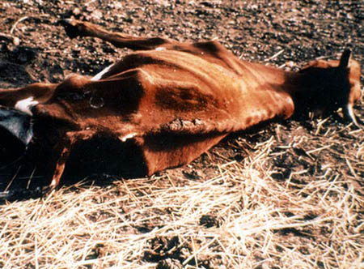
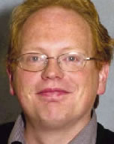
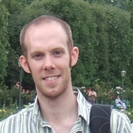
Steve Kemp
Andy Brass
Trypanosomiasis (Sleeping Sickness) in sub-Saharan Africa Microarray data QTL data
Paul Fisher
Slides from Paul Fisher
http://www.genomics.liv.ac.uk/tryps/
Notes:
30
Billions of dollars in lost livestock

Slide 31
Cattle Disease Research
$4 billion US
Different breeds of African Cattle
some resistant
Some susceptible
African Livestock adaptations:
More productive
Increases disease resistance
Selection of traits
Potential outcomes:
Food security
Understanding resistance
Understanding environmental
Understanding diversity
http://www.bbc.co.uk/news/10403254
Notes:
31

Slide 32
QTL + Microarrays
Notes:
32

Slide 33
Reuse, Recycle, Repurpose Workflows
Identify QTg and pathways implicated in resistance to Trypanosomiasis in cattle
Dr Paul Fisher
Dr Jo Pennock
Identify the QTg and pathways of colitis and helminth infections in the mouse model
PubMed ID: 20687192
doi:10.1186/1471-2164-14-127
Notes:
33
Levison S.E., McLaughlin J.T., Zeef L.A.H., Fisher P., Grencis R.K., Pennock J.L.: Colonic transcriptional profiling in resistance and susceptibility to Trichuriasis: phenotyping a chronic colitis and lessons for iatrogenic helminthosis. Inflammatory Bowel Diseases (2010), Accepted

Slide 34
Another Host, Another Parasite...but the SAME Method
Mouse whipworm infection - parasite model of the human parasite - Trichuris trichuria
Understanding Phenotype
Comparing resistant vs susceptible strains – Microarrays
Understanding Genotype
Mapping quantitative traits – Classical genetics QTL
Joanne Pennock, Richard Grencis
University of Manchester
Notes:
34
34

Slide 35
Workflow Results
Identified the biological pathways involved in sex dependence in the mouse model, previously believed to be involved in the ability of mice to expel the parasite.
Manual experimentation: Two year study of candidate genes, processes unidentified
Workflow experimentation: Two weeks study – identified candidate genes
Joanne Pennock, Richard Grencis
University of Manchester
Notes:
35
35

Slide 36
Workflow Success
Workflow analysed each piece of data systematically
Eliminated user bias and premature filtering of datasets
The size of the QTL and amount of the microarray data made a manual approach impractical
Workflows capture exactly where data came from and how it was analysed
Workflow output produced a manageable amount of data for the biologists to interpret and verify
“make sense of this data” -> “does this make sense?”

Slide 37
Spectrum of Users
Advanced users design and build workflows (informaticians)
Intermediate users reuse and modify existing workflows or components
Others “replay” workflows through web page
Notes:
Local or remote enactment
37

Slide 38
A Collection of Tools
Workflow Repository
Workflow GUI Workbench
and 3rd party plug-ins
Client User Interfaces
Web Portals
Service Catalogue
Taverna
E-Laboratories
Provenance Store
Workflow Server
Programming and
APIs
Activity and Service Plug-in Manager
W3C PROV
Secure Service Access, and Programming APIs
Notes:
38
38
38

Slide 39
Summary – Workflow Advantages
Informatics often relies on data integration and large-scale data analysis
Workflows are a mechanism for linking together resources and analyses
Promote reproducible research
Find and use successful analysis methods developed by others with myExperiment
Notes:
39

Slide 40
More Information
Taverna
http://www.taverna.org.uk
myExperiment
http://www.myexperiment.org
BioCatalogue
http://www.biocatalogue.org
Notes:
40
40
40

Slide 41
Tutorials
Using Taverna to design and build workflows
Reusing workflows from myExperiment
Finding and using different services:
REST, Xpath, Beanshell, R, …
Exploring the workflow engine: iteration, looping, retries, parallel invocation
Web: Taverna Online, Taverna Player
Interactions
Components
Notes:
41

